Slide 1
Information About Different Residency Programs
Giorgi Sabakhtarishvili
DTMU 5th year student

Slide 2
PGY 1
UCSD/VA General Surgery 4-6 months
Trauma Surgery 1 month
Burn Surgery 1 month
Vascular Surgery 1 month
CT Surgery 1 month
Neurosurgery 1 month
Orthopedics 1 month
Otolaryngology 1 month
General Surgery
San Diego School of Medicine

Slide 3
PGY 2
UCSD/VA General Surgery 4 months
Surgical ICU 1 month
Transplant 1 month
CT Surgery 1 month
Vascular Surgery 2 months
Burn Surgery 1 month
Plastic Surgery 1 month

Slide 4
PGY 3
UCSD/VA General Surgery 4 months
Trauma Surgery 2 months
Vascular Surgery 1 month
Children's Hospital 2 months

Slide 5
PGY 4
UCSD/VA General Surgery 5 months
Trauma Surgery 2 months
General Surgery 4 months
Vascular Surgery 1 month

Slide 6
PGY 5
UCSD/VA General Surgery 10 months
Vascular Surgery 2 months

Slide 7
Duty Hour Requirements
80 hours AVERAGED over 4 weeks
Continuous hours ->24 + 6 = 30 hours
Days off -> 1:7 on average
10 Hour respite between shifts
Working hours for PGY II residents and above, Monday to Friday are 6:00 a.m. – 6:00 p.m.
Working hours for PGY I residents is either 6:00 a.m. - 7:00 p.m. or 6:00 p.m. to 7:00 a.m.
PGY I duty period does not exceed 16 hours in duration.
PGY II and above duty hour is a maximum of 24 hours of continuous duty in the hospital with strategic napping after 16 hours of continuous duty and/or between 10:00 p.m. and 6:00 a.m. 2-3 hours of napping will be arranged
PGY-2 residents and above must be scheduled for in-house call no more frequently than every-third-night

Slide 8
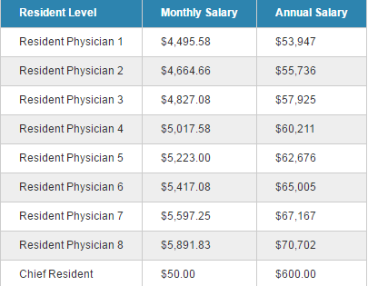
Educational Stipend (4800) to all residents
Licensing Fees and USMLE Step III application fees are paid by hospital
Four weeks of paid vacation per year
Insurance Coverage
Life Insurance
Salary

Slide 9
PGY 1
6 Months Neurosurgery
3 Months Neuro critical care/neuroendovascular
1 Month of ENT and 1 month of surgical ICU
Neurosurgery

Slide 10
PGY 2 & PGY 3 PGY 4 & PGY 5 PGY-6 PGY 7
Junior Neurosurgery Resident
Research/Elective
Neurosurgery Senior Resident
Chief Resident

Slide 11
Plastic Surgery
Independent (3y prerequisite training in general surgery)
Integrated (6y)

Slide 12
Plastic Surgery Prerequisites
18 months devoted to:
1. Abdominal Surgery 2. Alimentary Tract Surgery 3. Breast Surgery 4. Critical Care 5. Emergency Medicine 6. General Surgery 7. Pediatric Surgery 8. Surgical Oncology 9. Transplant 10. Trauma 11. Vascular Surgery
6 months devoted to:
1. Cardiothoracic Surgery 2. Gynecology 3. Neurologic Surgery 4. Surgical Pathology 5. Urology

Slide 13
North Carolina School of Medicine
1. Applicants should have graduated from a US medical school or outstanding international medical school. 2. Applicants should have inservice examination scores that are stable or reflect improvement, and there should be no single-digit results. 3. Applicants should have a strong interest in research as evidenced by scholarly activity including but not limited to poster presentations, oral presentations, journal publications, and/or textbook chapters. 4. Applicants should demonstrate dedication to quality improvement, international volunteerism, and/or altruistic causes. 5. Applicants should have recommendation letters that reflect strong clinical acumen, technical skills, scientific interest, interpersonal skills, and ethical character.

Slide 16
Vascular Surgery
0+5y (Eligible for board certification in vascular surgery only)
May include 1-2y of research
4+2y (Eligible for vascular surgery and general surgery certification, ESP)
5+2y (Eligible for board certification in both general surgery and vascular surgery)

Slide 17
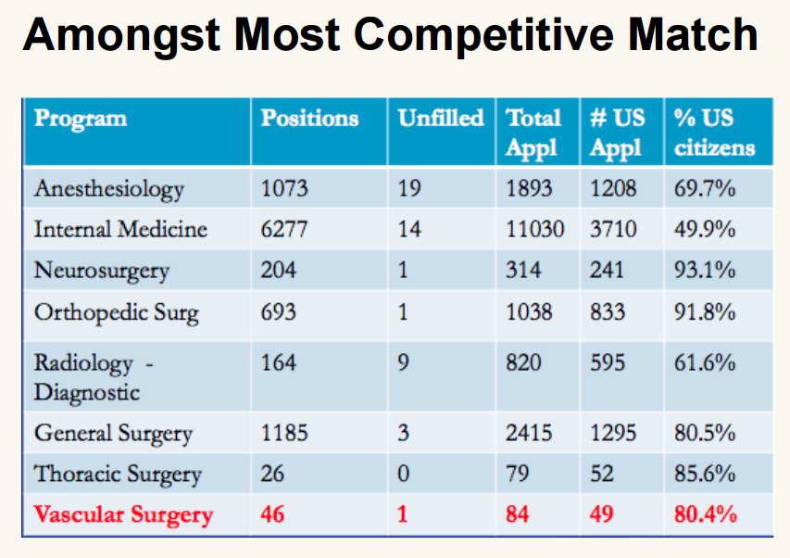

Slide 18
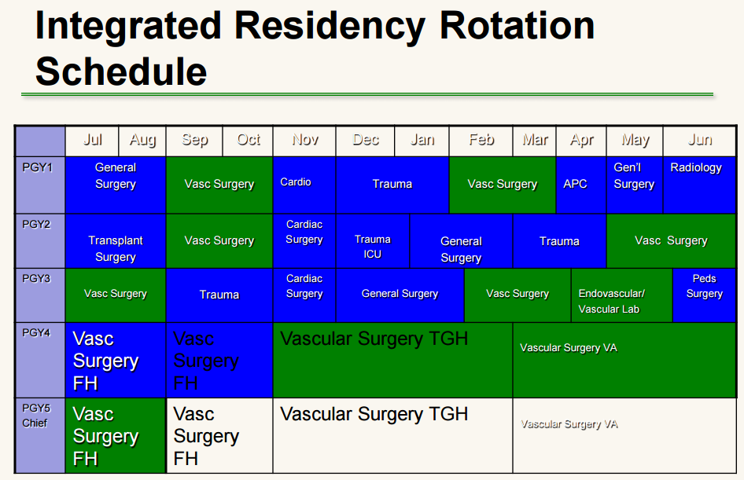

Slide 19
Cardiothoracic surgery
Integrated Pathway (5 Years General Surgery, plus 2-3 Years Cardiothoracic Surgery)
Fast-track Pathway (4 Years General Surgery, 3 Years Cardiothoracic Surgery)
Integrated Pathway (6 Years Cardiothoracic Surgery)

Slide 20
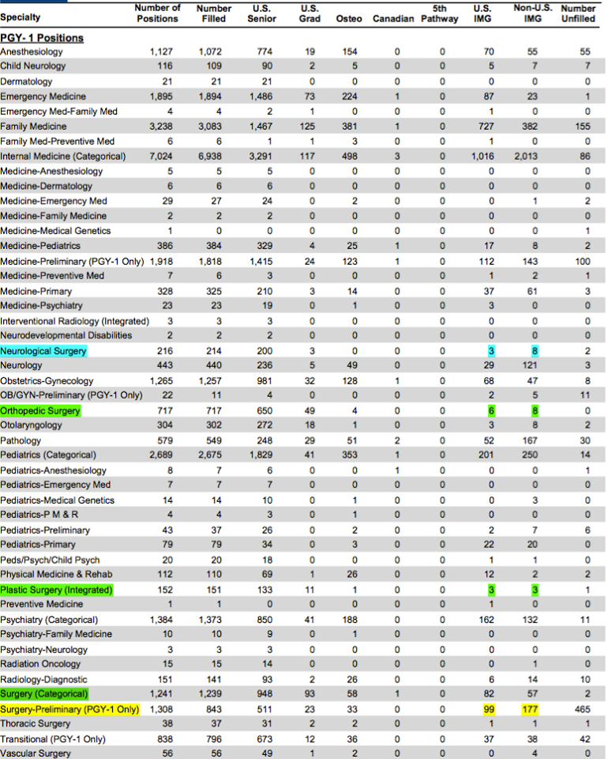

Slide 21
Trauma Surgery
Fellowship (1 year)
USMLE Step 1 and possibly Step 2 scores required.

Slide 22
PGY 1 PGY 2
Obstetrics and Gynecology
Labor and Delivery (OB service) day shift- 3 months Gyn Surgery - 2 months Ambulatory OB/GYN (clinic) - 2 months Night Labor & delivery - 2 months Breast/Endocrinology - 1 month Ultrasound/Research - 1 month Family Practice - 1 month
Labor & Delivery (OB Service) day shift - 3 months Night Labor & Delivery - 2 months Gyn Surgery - 3 months Ambulatory OB/GYN (Clinic) - 2 months Urogynecology - 1 month Reproductive Endocrinology - 1 month

Slide 23
PGY 3 PGY 4
Labor and Delivery - 3 months Night Labor and Delivery - 2 month Gyn Surgery/Gyn Oncology - 3 months Ambulatory OB/GYN (Clinic) - 3 months Pediatric/Menopausal Medicine - 1 month
Labor and Delivery (OB Service) - 3 months Gyn Surgery - 3 months Ambulatory OB/GYN (clinic) - 3 months Electives - 3 months

Slide 24
Weeknight Call
"night float" system
The night call residents work from 6 p.m. through 8 a.m., Sunday through Thursday nights. The night call residents typically leave the hospital by 8:30 a.m., following morning "board" rounds. PGY-4 residents take call from home.
Weekend Call
The PGY-2 or 3 resident and PGY-1 resident assigned call on Friday evening will work from 5 p.m. until Saturday at 8 a.m. The PGY-2 or 3 resident and PGY-1 resident assigned call on Saturday will work from 8 a.m. Saturday until 8 a.m. Sunday. The PGY-2 or 3 resident and PGY-1 resident assigned call on Sunday will work from 8 a.m. Sunday until 6 p.m. PGY-4 residents take call from home.

Slide 25
Categorical VS Preliminary
“Categorical” offers full residency training
“Preliminary” offers one to two years of training prior to entry into advanced specialty programs.
“Transitional” – not speciality focused. Offers intern experience in surgery and internal medicine.

Slide 26
Medical Hierarchy
↓ Medical director
↓ Head of department
↓ Attending physician or hospitalist
↓ Fellow
↓ Chief resident
↓ Senior resident (usually third year resident)
↓ Junior resident (usually second year resident)
↓ Intern (first year resident)
↓ Medical student

Slide 27
Thank you

