Slide 1

Surgical basics – Sterility/Asepsis
Speaker:
Alexandre Asatiani,
5th year student, DTMU

Slide 2
Surgical attire
Sterile fields
Surgical hand hygiene
Gowning & Gloving
Notes:
ქირურგიული ფორმა
სტერილური არე/სივრცე
ხელების ქირურგიული ჰიგიენა
ქირურგიული ხალათის ჩაცმა
ქირურგიული ხელთათმანების ჩაცმა

Slide 3
Terminology/glossary
Aseptic – free from disease-causing/pathogenic microorganisms (ex. bacteria, viruses, etc.)
Sterile - free from all living organisms Including from non-pathogenic and pathogenic microorganisms.
Contamination - the process of becoming unsterile or unclean
Sterile field - a specified area that is considered free from micro-organisms
Sterile Techniques - methods used to assure that an environment is as pathogen-free as possible.
Sterilization - process that eliminates all biological contaminants.
Surgical Asepsis/Sterile techniques - Used interchangeably

Slide 4
Scrub suit
Surgical cap/hair coverings
Surgical mask
Shoe covers/surgical shoes
Protective eyewear
Barrier jacket (if only observing)
Surgical gown
Gloves
Before entering
semi-restricted zone
Before entering Operating Room (OR)
After Scrubbing

Slide 5
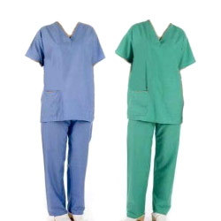
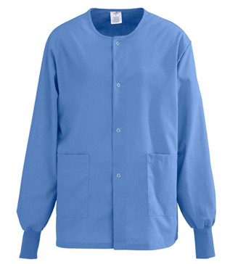
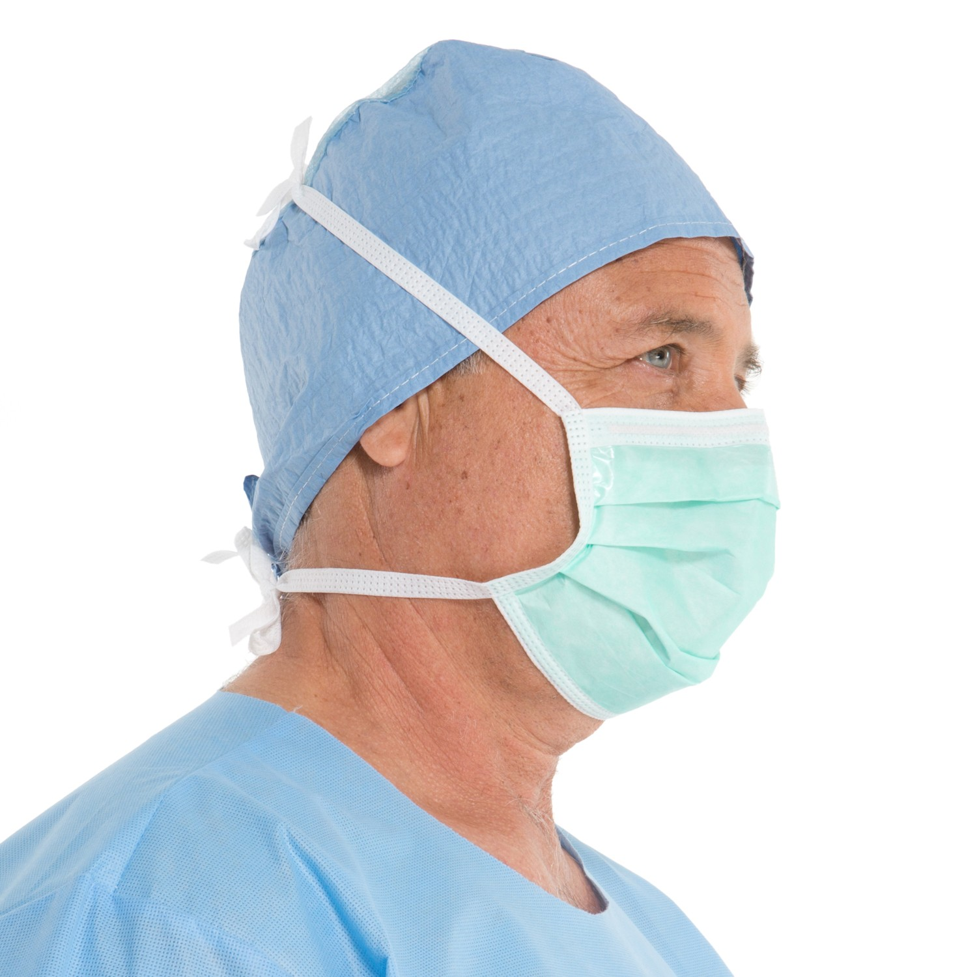


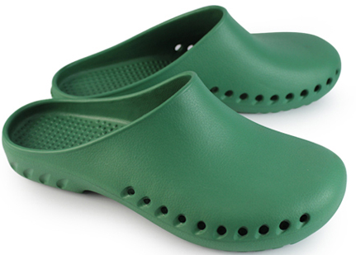
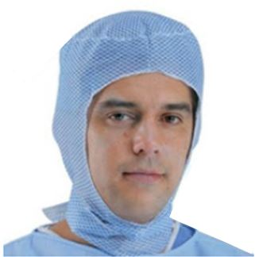
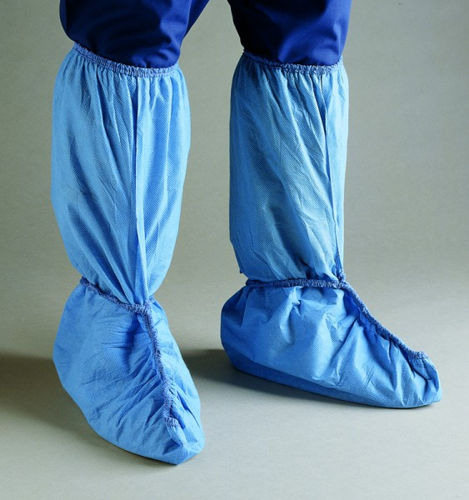
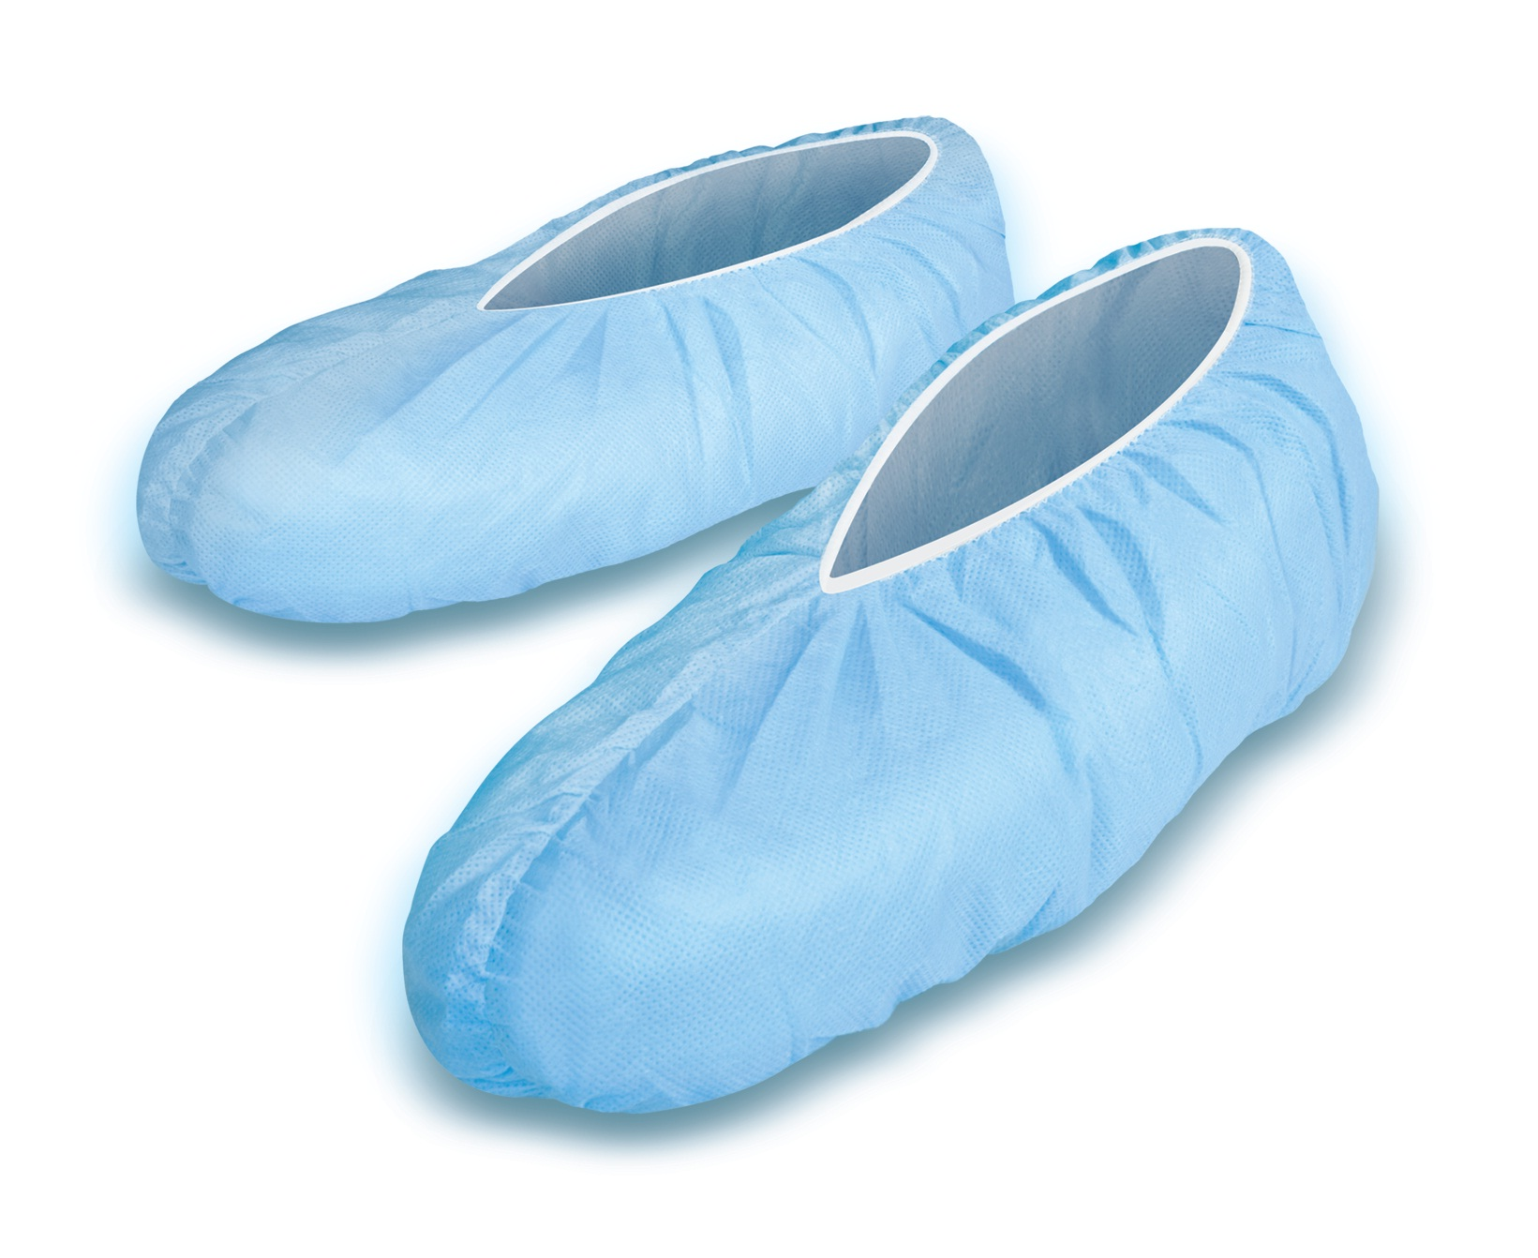
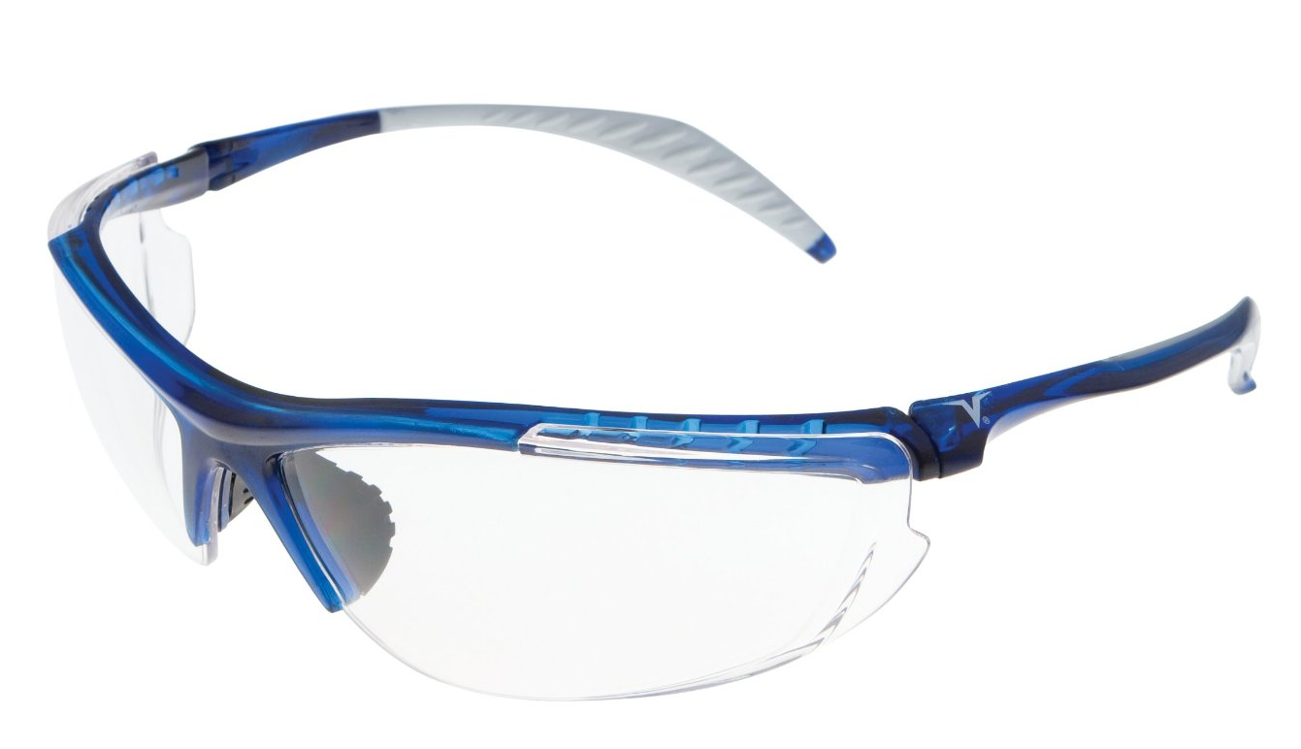
Notes:
Surgical cap - falling hair or dandruff.
Footwear –bodily fluids/blood (non-slip surface, falling sharp objects)
Mask - exhaled bacteria (protects nose and mouth blood/fluid splashes)
Protective eyewear –blood/fluid splashes
Jacket – extra layer of protection and comfort.

Slide 6
Surgical cap - prevents possible contamination of the sterile field by falling hair or dandruff.
Footwear – limits OR contamination and prevents medical personnel contamination by bodily fluids/blood (also provides non-slip surface)
Mask - Protects the patient from exhaled bacteria by operating room personnel (also protects mucous membranes of nose and mouth from blood/fluid splashes)
Protective eyewear – protects eyes from blood/fluid splashes during operation
Jacket – extra layer of protection and comfort.

Slide 7
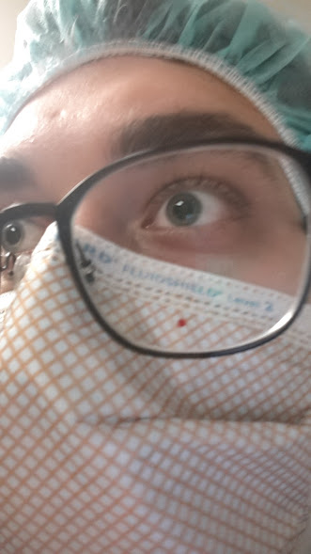
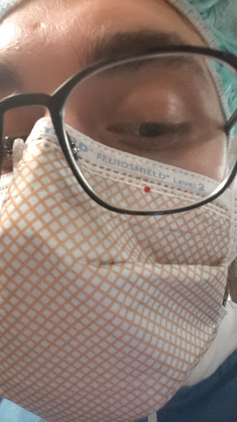
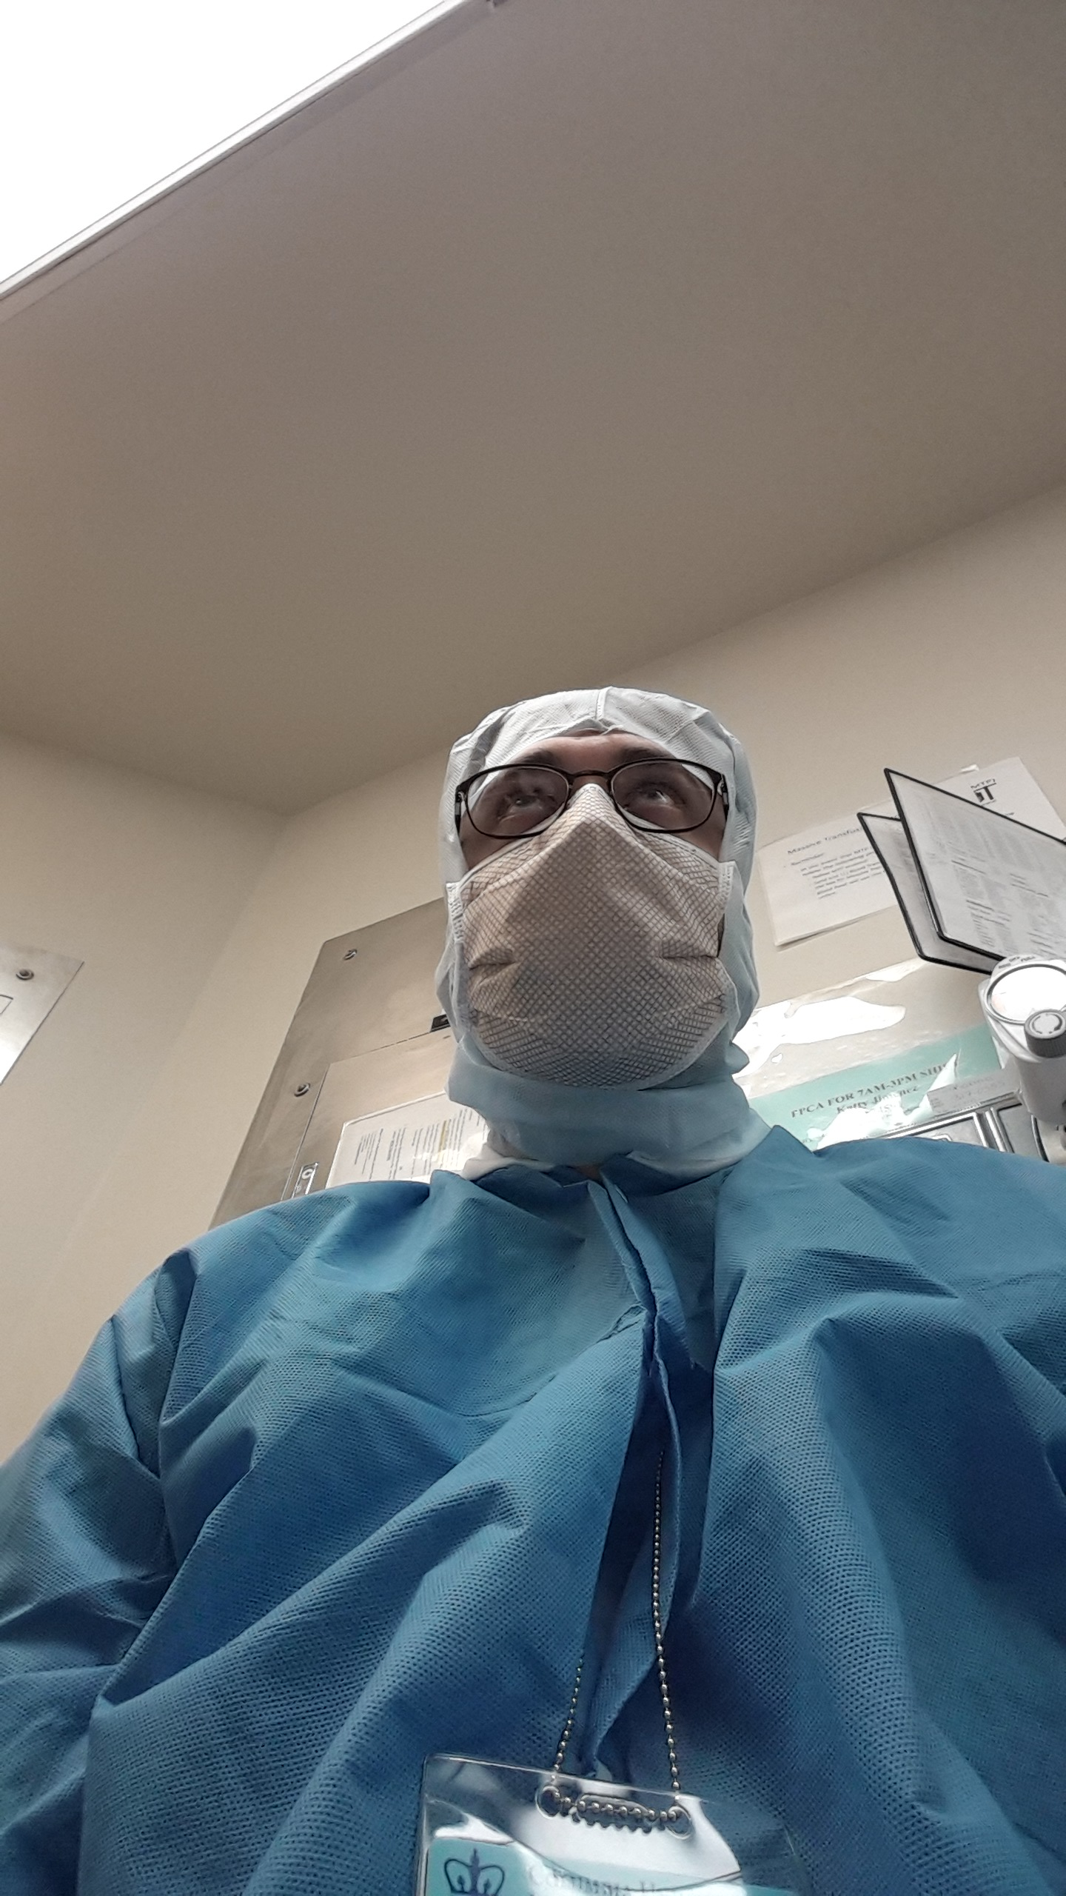

Slide 8
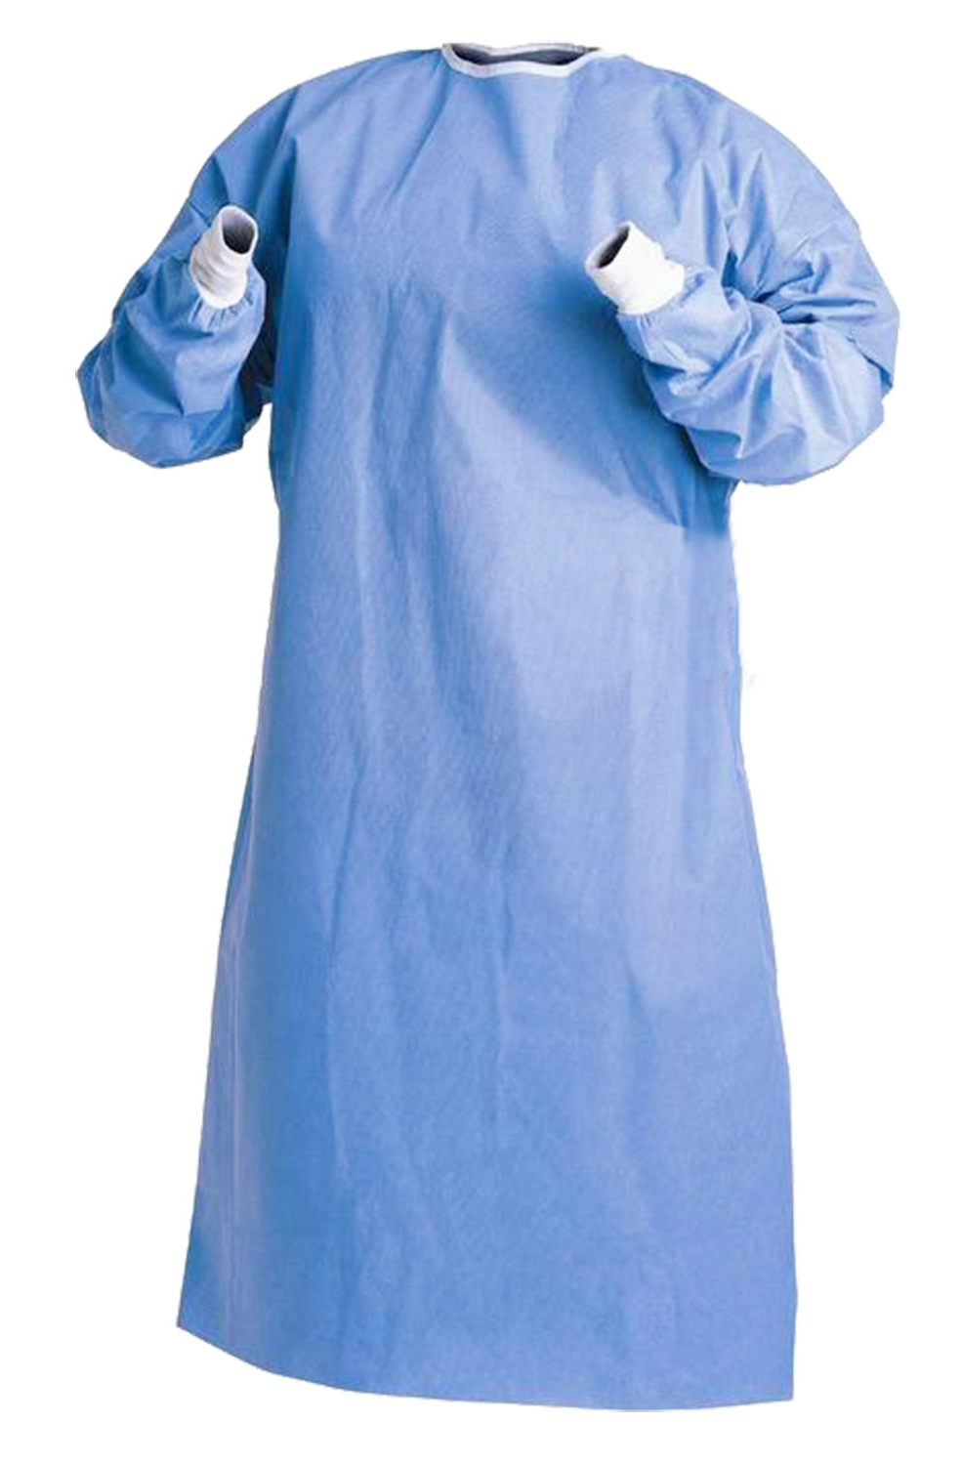
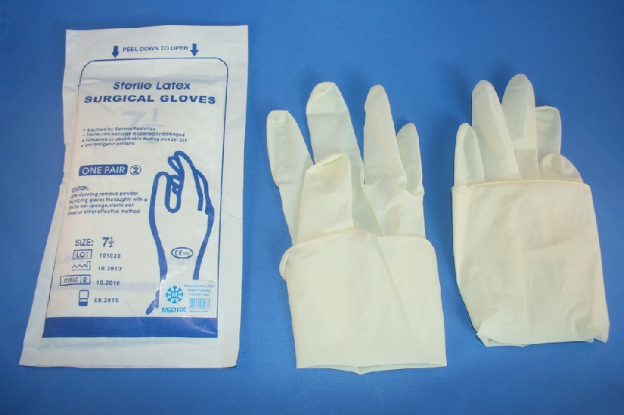
Only when participating in sterile procedures
Notes:
Only when participating in sterile procedures

Slide 9
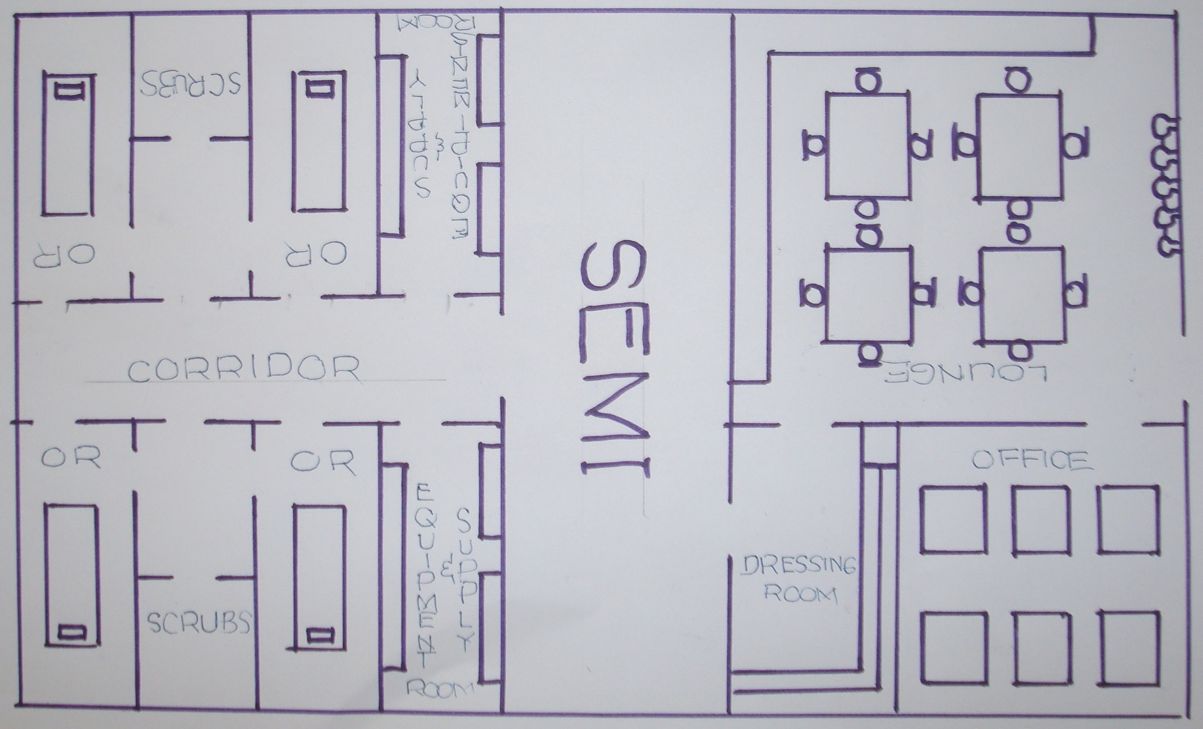
SEMI
SCRUB
Restricted
Semi-restricted
Unrestricted
SCRUB
Notes:
Surgical attire – clinical protocols
Restricted - zone
Semi-restricted - zone
Unrestricted - zone

Slide 10
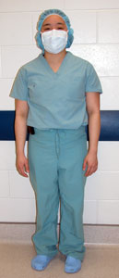
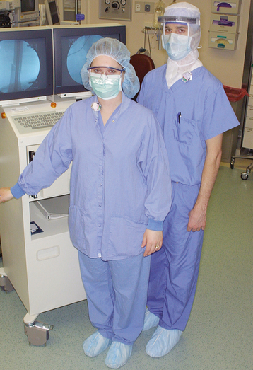
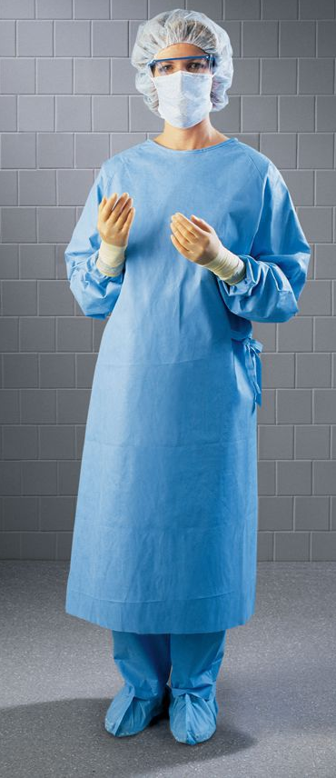
Protective Eyewear +
Jacket +
Gowns +
Gloves +
Protective eyewear -
Jacket -
“Surgical attire”
Summery
Ready to enter semi-restricted zone (or restricted zone)
Ready to observe
Ready to operate
(Not sterile)
(Sterile)
Notes:
Why do we need this many layers of surgical attire?
To preserve Sterile Field
Different hospitals – Different protocols

Slide 11
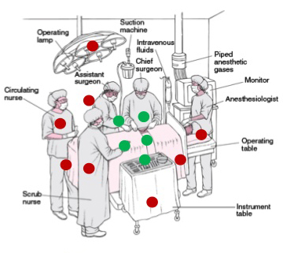

Sterile fields
“A specified area that is considered free from
micro-organisms”
Notes:
სტერილური არე/სივრცე
Medical student = Nightmare for nurses
who are responsible for integrity/maintenance of the sterile field
surgical protocol - preserve/maintain sterile fields.

Slide 12
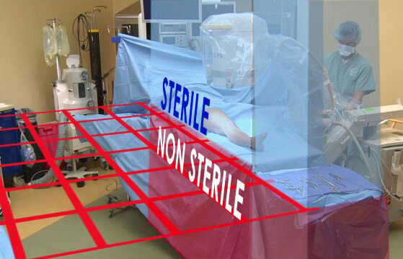
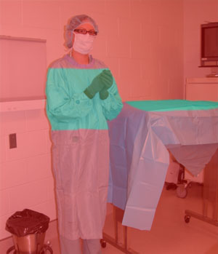
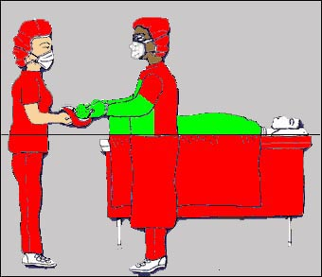

Always watch the sterile field!
Notes:
blue/green = Sterile field beware
Sterile drapes (საგები, ნაჭერი) used to cover surfaces – provides barrier, creates sterile field
edge of the drape is not considered sterile
Drapes are only sterile at table level.
Anything below table level is considered non-sterile

Slide 13
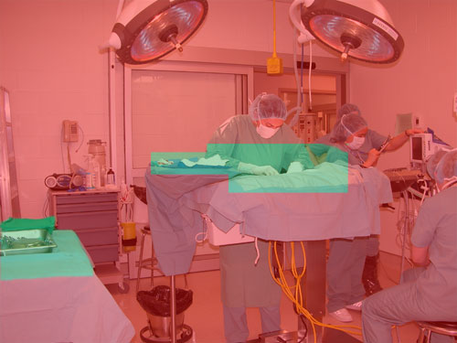
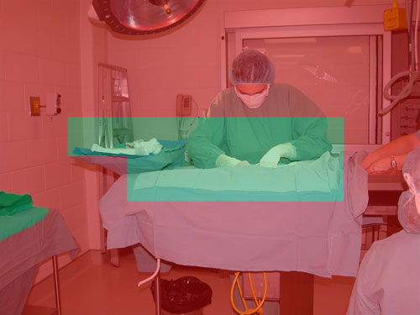
Notes:
Extra examples of sterile fields.

Slide 14

Only sterile items are used within the sterile field.
Notes:
Sterile to sterile non-sterile to nonsterile
Most of the surgical equipment (აღჭურვილობა) is wrapped.
The sterile boundary of a peel-open package is the inner edge.
Items should not be “flipped” or dropped onto the sterile field. – fig. 4

Slide 15
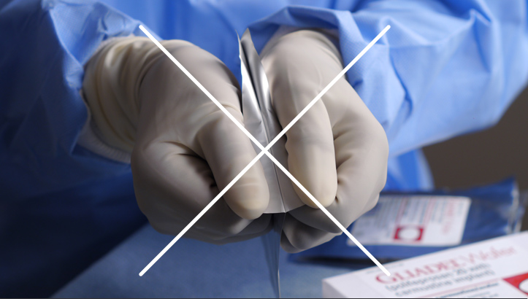
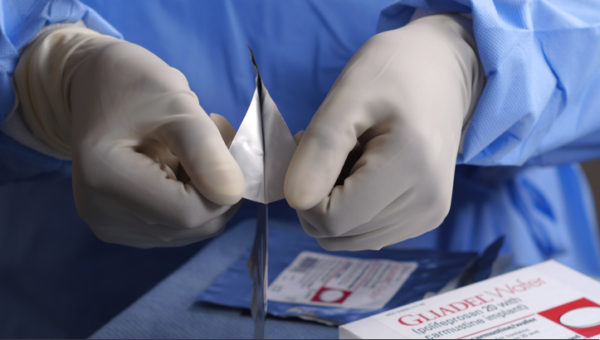
Always use slow and delicate movements
Notes:
do not pull downward motion – wrap may break (especially wrapped sharp objects)
slowly pull in an outward motion
Scrubbed assistant - opened first toward the sterile individual
circulating assistant - wrap is opened first away from the

Slide 16

Surgical hand hygiene
The contribution of the surgical scrub is critical in reducing the incidence of operative wound infections.
It is known that the individual person is the primary source of nosocomial bacteria in the operative setting.
Handwashing results in a significant reduction in pathogen carriage.
Notes:
significant reduction in pathogen carriage.
Reduce transmission of nosocomial bacteria (antibiotic resistant)
reducing the incidence of operative wound infections.

Slide 17
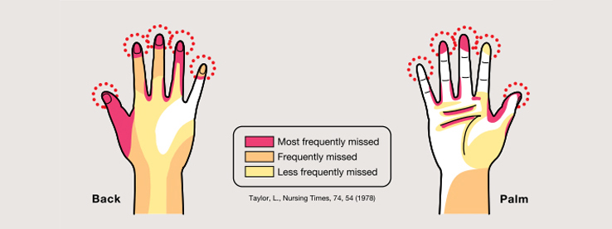
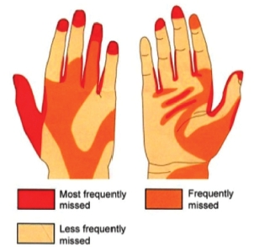
Microbial distribution after regular hand washing
Notes:
Most frequently missed areas (red)

Slide 18
Essential steps before scrubbing
Make sure fingernails are short (no longer than 5mm) clean and healthy (just like you). Nail polish and fake fingernails should be removed.
Remove jewelries (Rings, Bracelets).
Apply personal protective equipment(PPE) - surgical shoe covers, Cap, Facemask and protective eyewear.
If you have cuts, abrasions, weeping dermatitis or fresh tattoos
on exposed skin you should not scrub.
Notes:
Short fingernails - <5mm
Remove jewelries
damaged skin – not allowed to scrub
Apply personal protective equipment

Slide 19
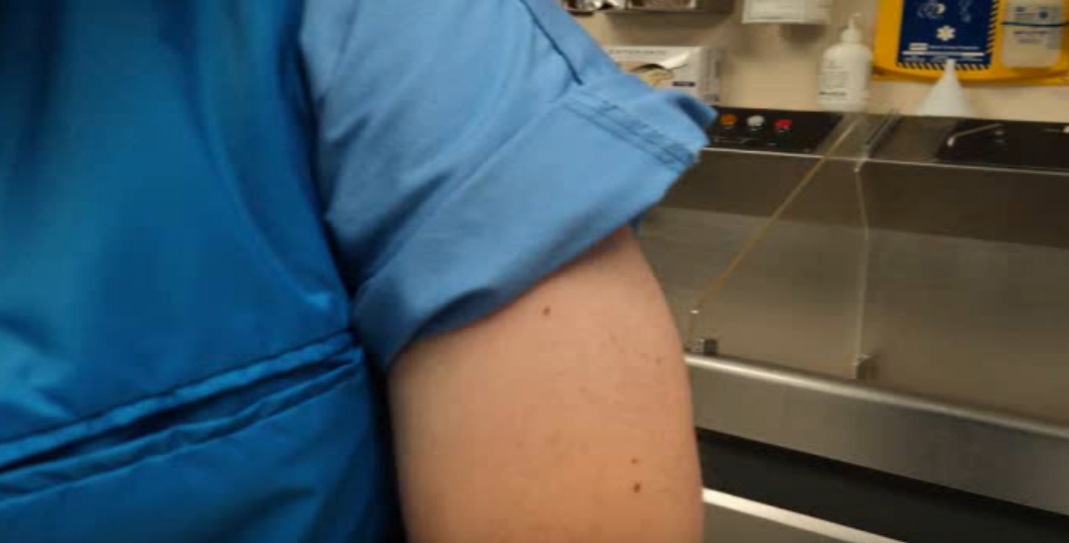
Essential steps before scrubbing
(continued…)
4. Roll up the sleeves of scrub top if there is a risk of OR attire getting wet.
5. If hands are visibly soiled, remove soil by washing hands and forearms with soap and water before starting the surgical scrub.

Slide 20
Surgical Scrubbing Protocols
Traditional method (water-based)
Non-traditional method
(alcohol based)

Slide 21
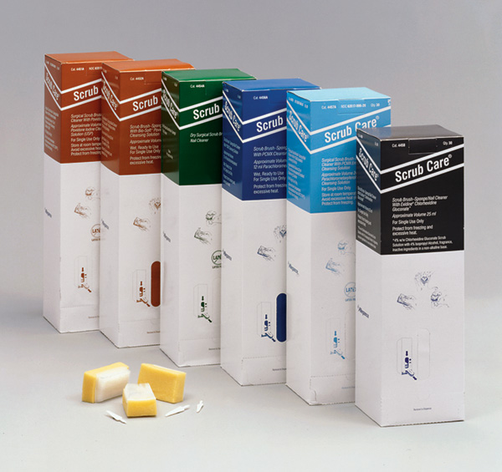
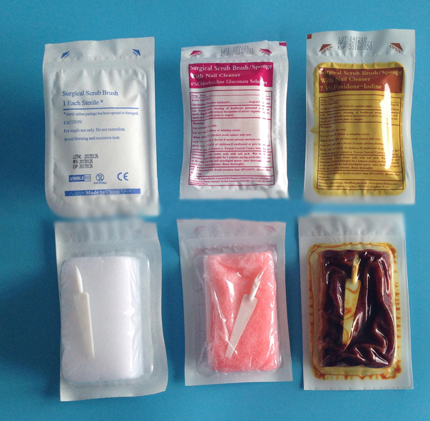
Traditional method (water-based)
Surgical scrub brush technique
Brushless surgical scrub technique

Slide 22
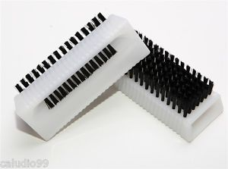
Surgical scrub brush that we will use
(only for fingers, nails and cuticles)

Slide 23
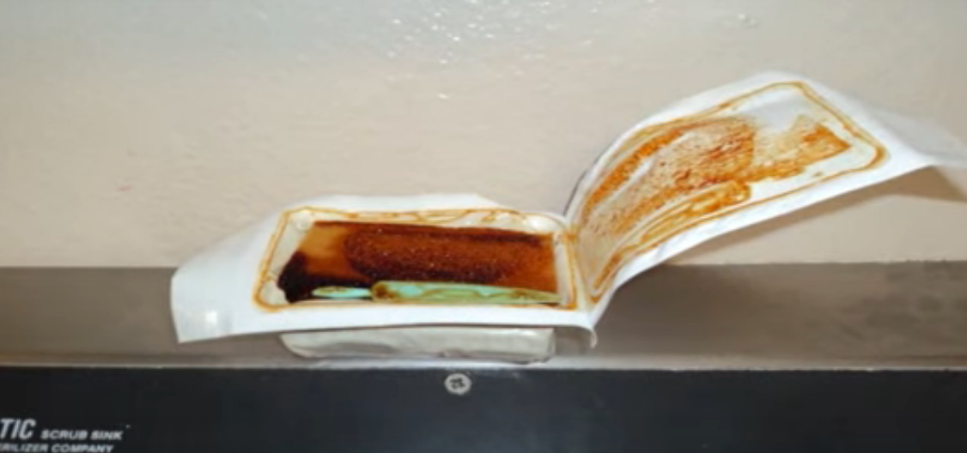
Surgical scrub brush technique
Use an approved scrub solution according to the manufacturer’s written instructions.
Open surgical scrub brush and put it at accessible location
Before using surgical scrub brush Perform basic hand wash
Clean under the nail (subungual areas) of both hands under running water using a disposable nail cleaner.
Rinse hands and forearms under running water

Slide 24
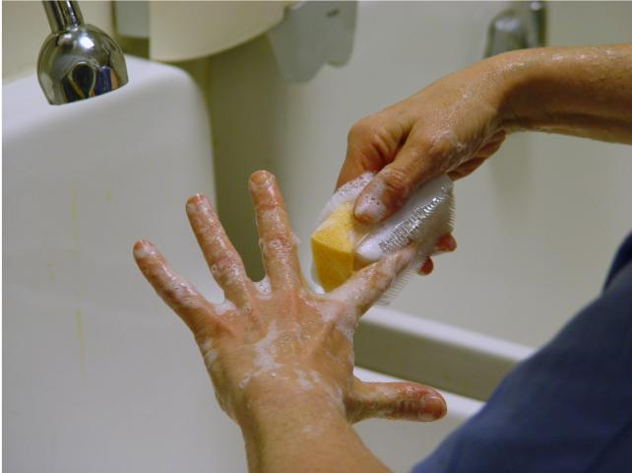
Apply the scrub solution to wet hands and forearms. Sponges, if used, must be soft and non-abrasive.
For each hand visualize each finger, thumb, hand and arm as having four sides. Wash all four sides effectively, keeping the hands elevated.
Avoid splashing surgical attire.
Discard sponge (if used) after use.
Notes:
While washing - don’t damage your skin
Wash all four sides effectively - hands elevated
Avoid splashing – not to wet attire

Slide 25
Rinse hands and arms under running water in one direction from the fingertips to elbows as often as needed to remove soap. Care must be taken to ensure fingers, hands and arms do not touch the faucet and the hands remain above the level of the elbows. If the water is controlled with hand control levers then the water must be turned off by a circulating assistant.
Notes:
Rinse hands – from fingertips to elbows
care – do not touch anything
hands higher than elbows

Slide 26
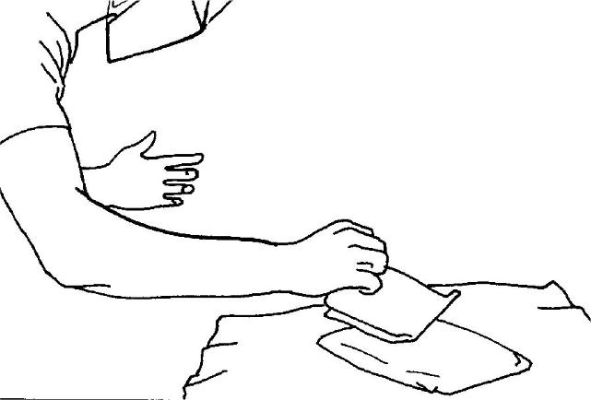
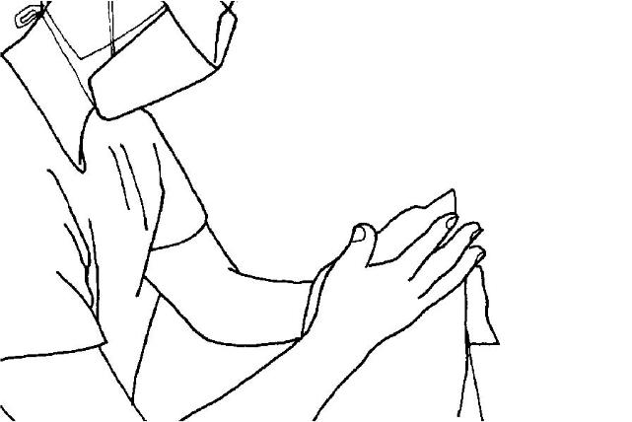
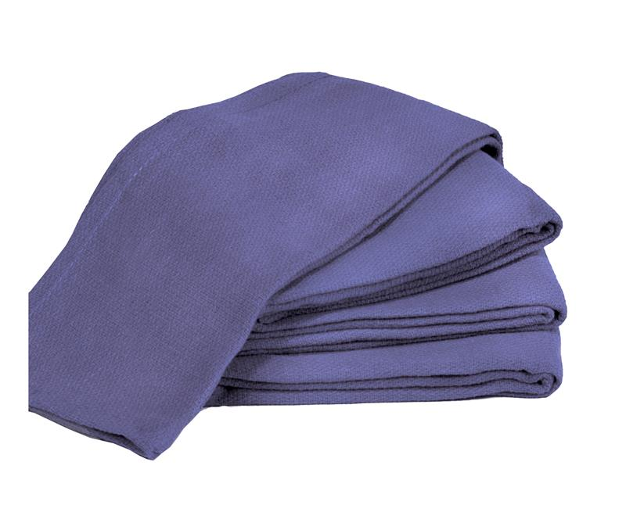
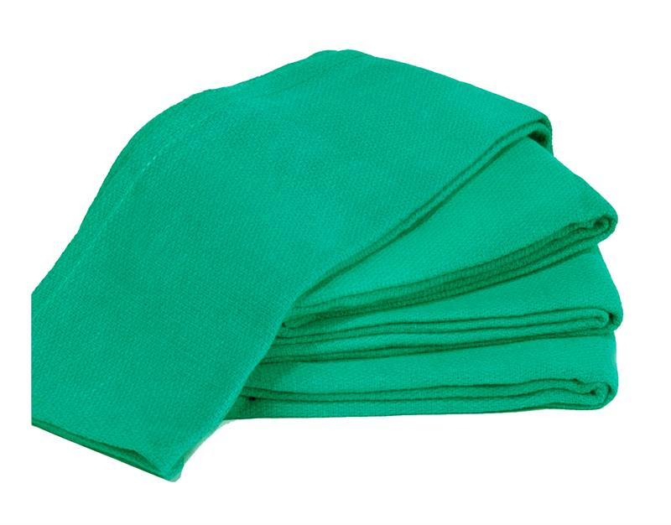
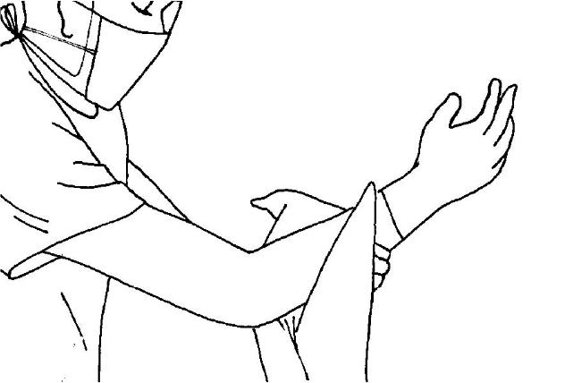
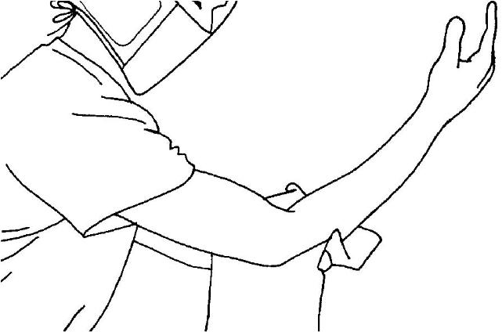
Ensure hands are held away from the body with hands and forearms held higher to prevent contamination by allowing the water to run from the clean to less clean area. Keep the surgical attire dry as the sterile gown cannot be donned over wet or damp attire without potential contamination of the gown by strike-through moisture.
Dry hands with a sterile towel.
Notes:
Hands – away from the body
forearms held higher – water run from clean to less clean area

Slide 27
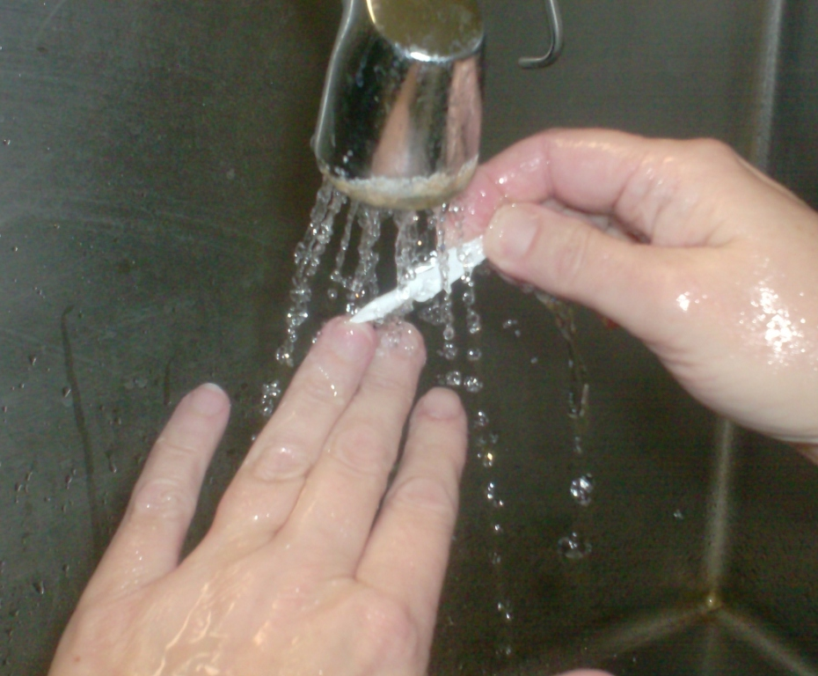
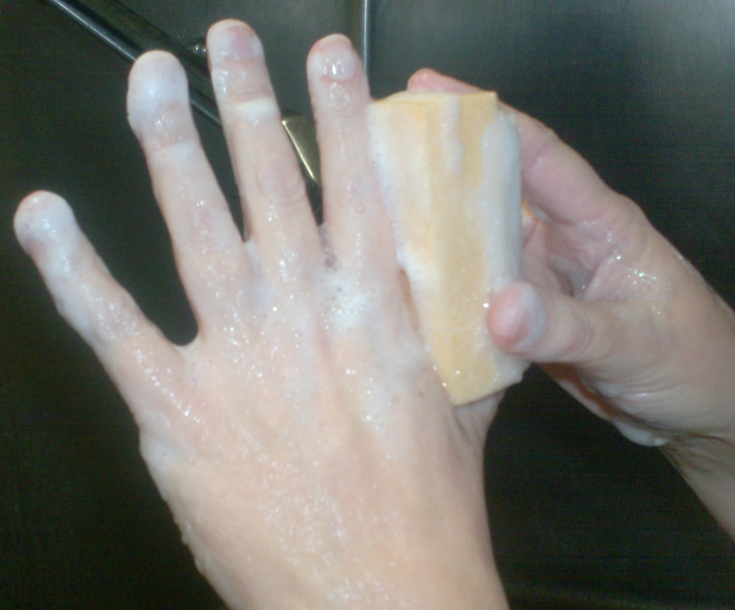
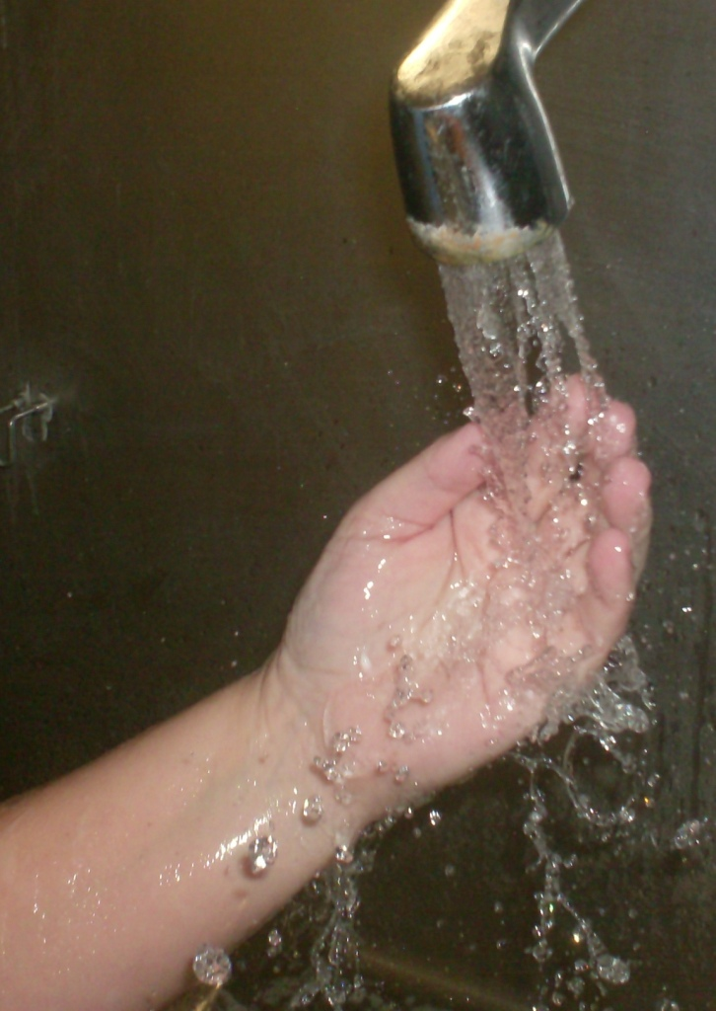
Step 1
Wet hands and arms up to the elbows.
Use nail pick to clean nails under running water.
Step 2
Wet sponge and squeeze to work up lather.
Wash each finger, hand, and arm to two inches above the elbows using the non abrasive sponge for a total scrub time of three minutes.
Note: Use brush side only on nails and cuticles or on areas of visible soil.
Step 3
Rinse hands and arms from finger tips to elbows. Dry hands and arms with a sterile towel.
Summary
Notes:
1 – Clean nails
2 – Brush all sides of hand/fingers
3 – rinse from finger tips to elbows and dry

Slide 28
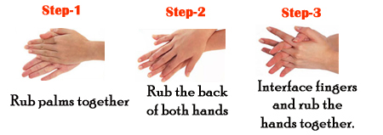
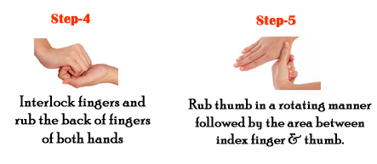
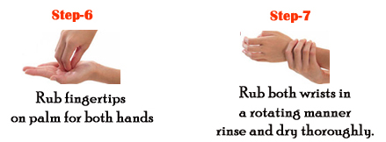
Brushless surgical scrub technique

Slide 29
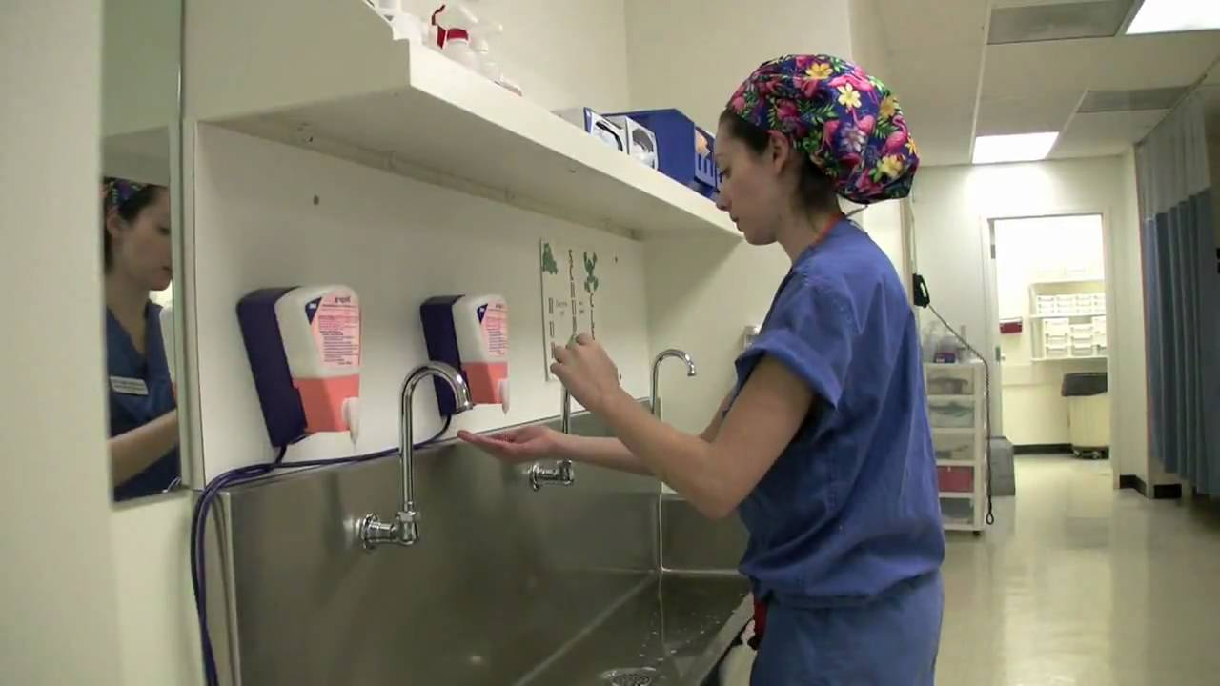
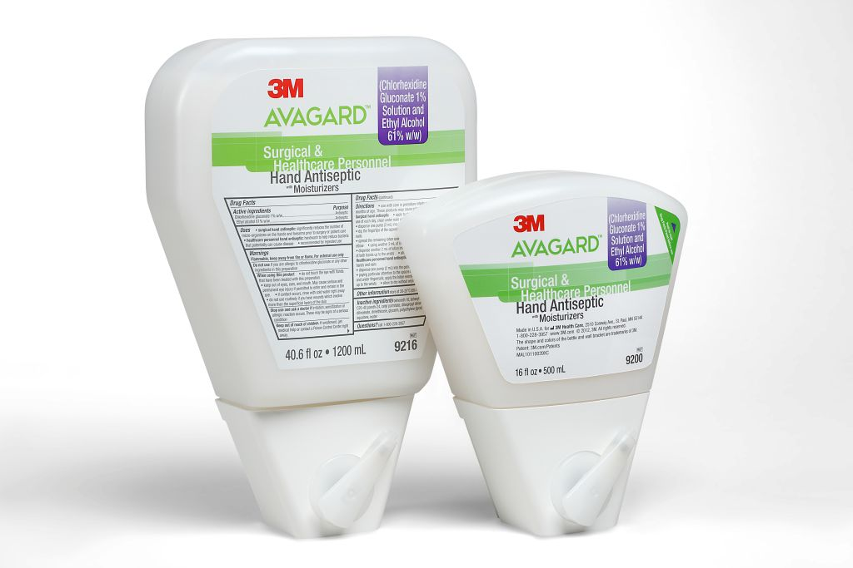
Non-traditional method (alcohol based)
AVAGARD
3 pump technique
Wash hands and pick nails before first application
Wash and dry hands if soiled before any subsequent applications
Notes:
Wash hands and pick nails - first application
Dry hands – before using

Slide 30
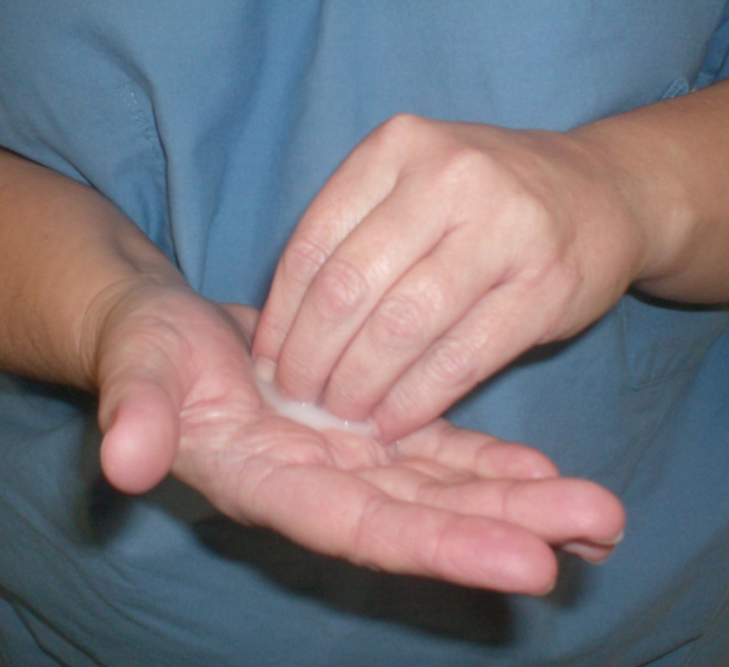
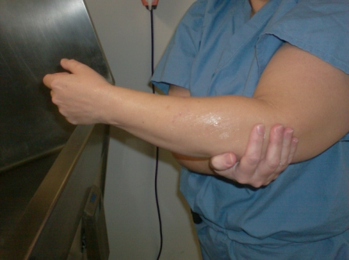
Pump
1
Dispense one pump (2ml) into the palm of one hand. Dip fingertips of the opposite hand into the hand prep and work under fingernails. Spread remaining hand prep from wrist to 2” above the elbow.

Slide 31
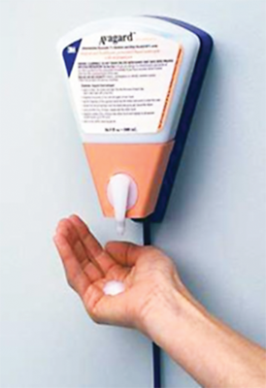

Pump
2
Dispense one pump (2ml) and repeat procedure with opposite hand/arm.

Slide 32


Pump
3
Dispense final pump (2ml) of hand prep into either hand and reapply to all aspects of both hands up to the wrists.
Allow to dry - Do not use towels!

Slide 33


Slide 34

Gowning & Gloving
With
scrubbed assistant
Without
scrubbed assistant
Scrubbed Assistant
set ups, maintains the sterile field and assists the surgical team to perform the surgical procedure.
Notes:
Scrubbed assistant - sterile

Slide 35


Gowning Without Scrubbed Assistant
Notes:
Gown is folded inside-out.
Pick it up – step away from the table
Don’t touch outside of the gown -

Slide 36


Circulating Assistant
performs hand hygiene and assists sterile persons to gown, glove and set up the sterile field.
Notes:
Circulating Assistant – not sterile
Two ties (თასმა)
1 – by circulating nurse (non-sterile)
2 – by yourself (sterile)

Slide 37
Closed Gloving Technique

Slide 40

Open gloving technique without scrubbed assistant

Slide 42
Gowning WITH scrubbed assistant
Notes:
Assisted Gowning and Gloving Technique

Slide 43
Open Gloving WITH Scrubbed Assistant
Notes:
Double Gloving – Hepatitis, HIV, other infectious risks.
Long nails – rupture risk, painful, etc.

Slide 45

Sterile zone of the gown

Slide 46


Sterile zone of the gown
Notes:
Mistakes

Slide 47


Sterile zone of the gown
Notes:
Sterile zone may change with the position

Slide 48

Notes:
Pass each other back to back
margin of safety
sterile area
Never turn your back to sterile field

Slide 49
Thank you
for your attention!
Notes:
Please maintain discipline, comply to your tutors requests and do not use provided surgical attire without their permission.

Slide 50
Please maintain discipline, comply to your tutors requests and do not use provided surgical attire without their permission.

Slide 51

Notes:
Questions about workshop
SIGA
anything

