Slide 1
Essential Steps to a U.S. Medical Residency
Speaker:
Alexandre Asatiani,
5th year student, DTMU

Slide 2
Pass the USMLE
Graduate from medical school
Get the ECFMG certification
Apply for residency
Get visa

Slide 3
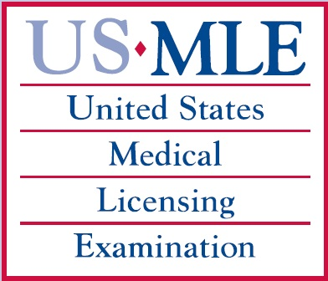
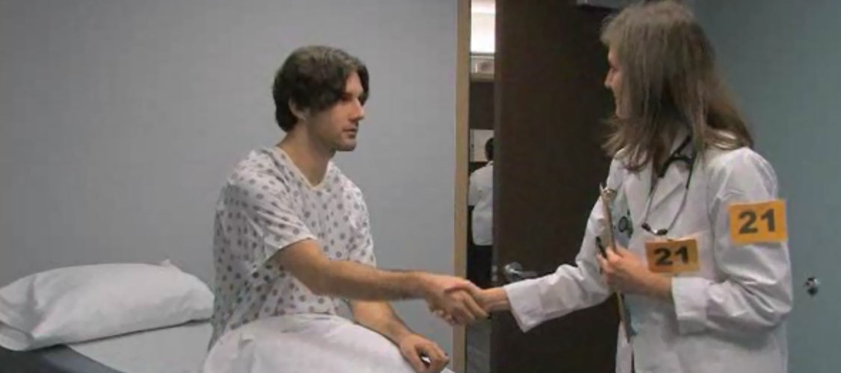
Step 1 – Pass the USMLE
Contents of USMLE:
Step 1 – “Basic Sciences”
Step 2 – CK (Clinical Knowledge) + CS (Clinical Skills)
Step 3 - Foundations of Independent Practice + Advanced Clinical Medicine

Slide 4
USMLE Step 1 Description:
Computer based
taken in a single day over an eight hour period – including 1 hour break
includes seven sections - 46 questions in each section, total of 322 questions
One hour is allotted for each of the seven sections.
you will have one minute and 18 seconds per question
Passed:
Can’t retake it to raise your previous score (for 7 years)
Failed:
You may take the USMLE Step 1 exam a maximum of three times within a 12-month period

Slide 5
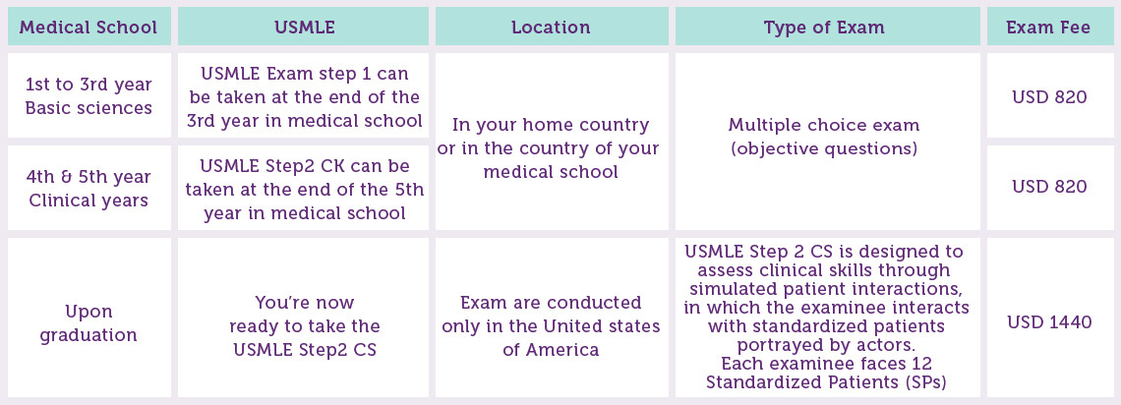

Slide 6
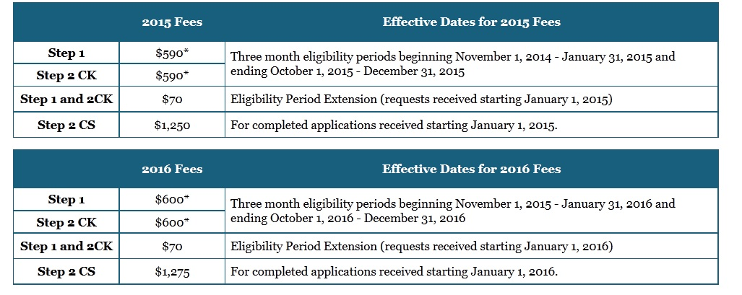
David Tvildiani Medical University provides full financial support concerning USMLE fees, but only for students who pass special selective examination with >75% score.

Slide 7
TEST FORMATS SUMMERY: Step 1: 322 MCQs, divided into 7/60-minute blocks, administered in 8-hour testing session Step 2 CK: 352 MCQs, divided into 8/60-minute blocks, administered in 9-hour testing session Step 2 CS: 12 patient cases/15 minutes for each patient encounter and 10 minutes to record each patient note. The testing session is 8-hours. Step 3: 480 MCQs/35 to 50 blocks/45 to 60 minutes. +9 computer-based case simulations/25 minutes. Step 3 is administered in 2/8-hour testing sessions

Slide 8
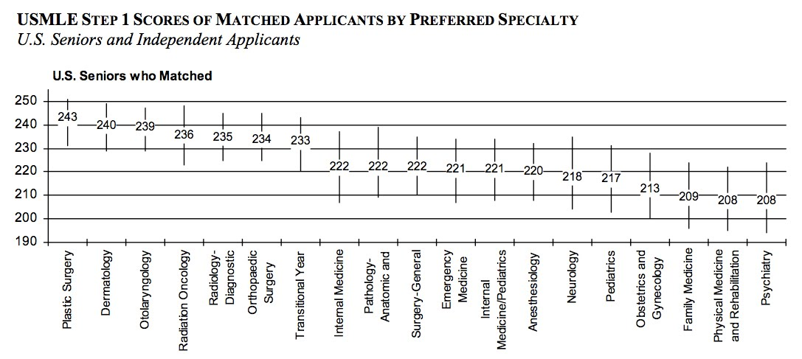
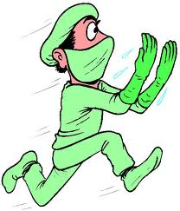
It’s NOT ENOUGH!!! You have to score at least 245/300

Slide 9
Step 2 – Graduate from DTMU
High GPA
“Activities”
GOOD - but relatively non-relevant
USMLE scores
US Clinical Experience
Recommendation letters.
Extremely important

Slide 10
US Clinical Experience (USCE)
Research
Hands on Clinical Experience
Non-hands on Clinical Experience
Clinical Elective
Clerkship
Sub-internship
Externship (postgraduate)
Observership
LETTER OF RECCOMENDATION (LOR)
Notes:
Elective - an optional away rotation that a final year medical student Clerkship - compulsory medical student clinical rotation that is part of your curriculum Sub-internship – same as elective + on-call participation with your team Externship – least respected hands on practice. You have to be ECFMG certified

Slide 11
LETTER OF RECCOMENDATION (LoR)
You may assign a minimum of 3 and a maximum of 4 LoRs per program:
3 LoRs from USA
1 LoR from Georgia
LoR should be specialty specific: ex. don’t use an Internal Medicine letter to apply to a General Surgery program
https://www.aamc.org/students/medstudents/eras/375006/resources-info2015.html (Electronic Residency Application Service)
http://www.ecfmg.org (Educational Commission for Foreign Medical Graduates)
http://www.nrmp.org (National Resident Match Program)

Slide 12
Contact program coordinator
Find your attending

Slide 13
Accepted = a lot of paperwork
CV
Malpractice Insurance
Health Insurance
Immunizations : Td, TB status, Varicella, MMR, Hepatitis B, annual flu vaccine and etc ( AAMC Standardized Immunization Form )
Medical School Approval - Support letter from the Dean’s office
Background Check – Criminal background
TOEFL
USMLE Step I (mainly required for hands on practice)

Slide 14
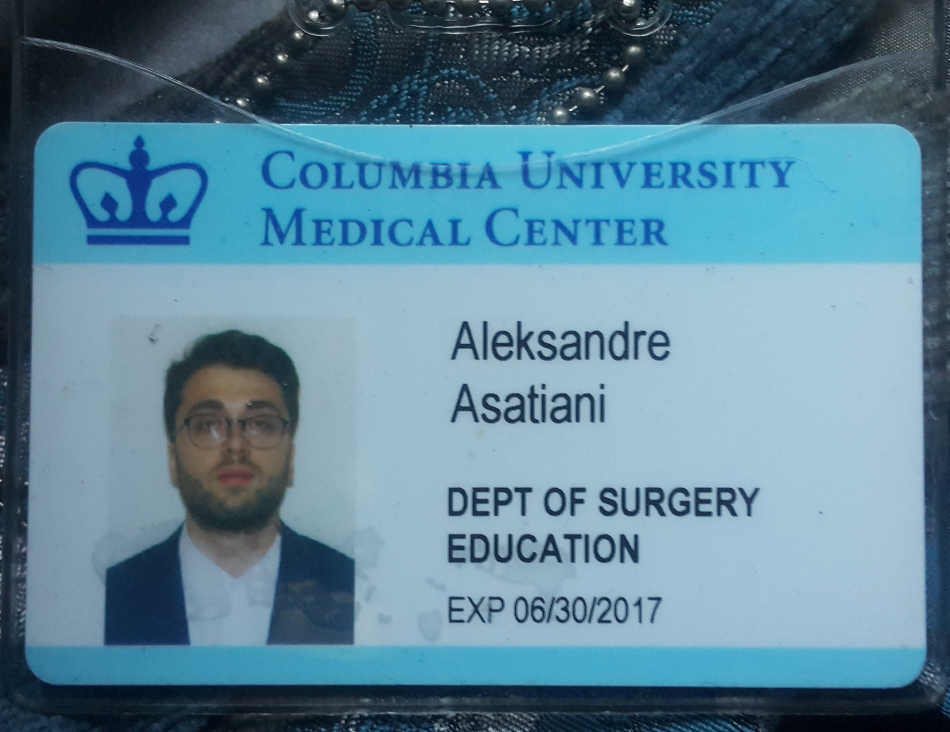
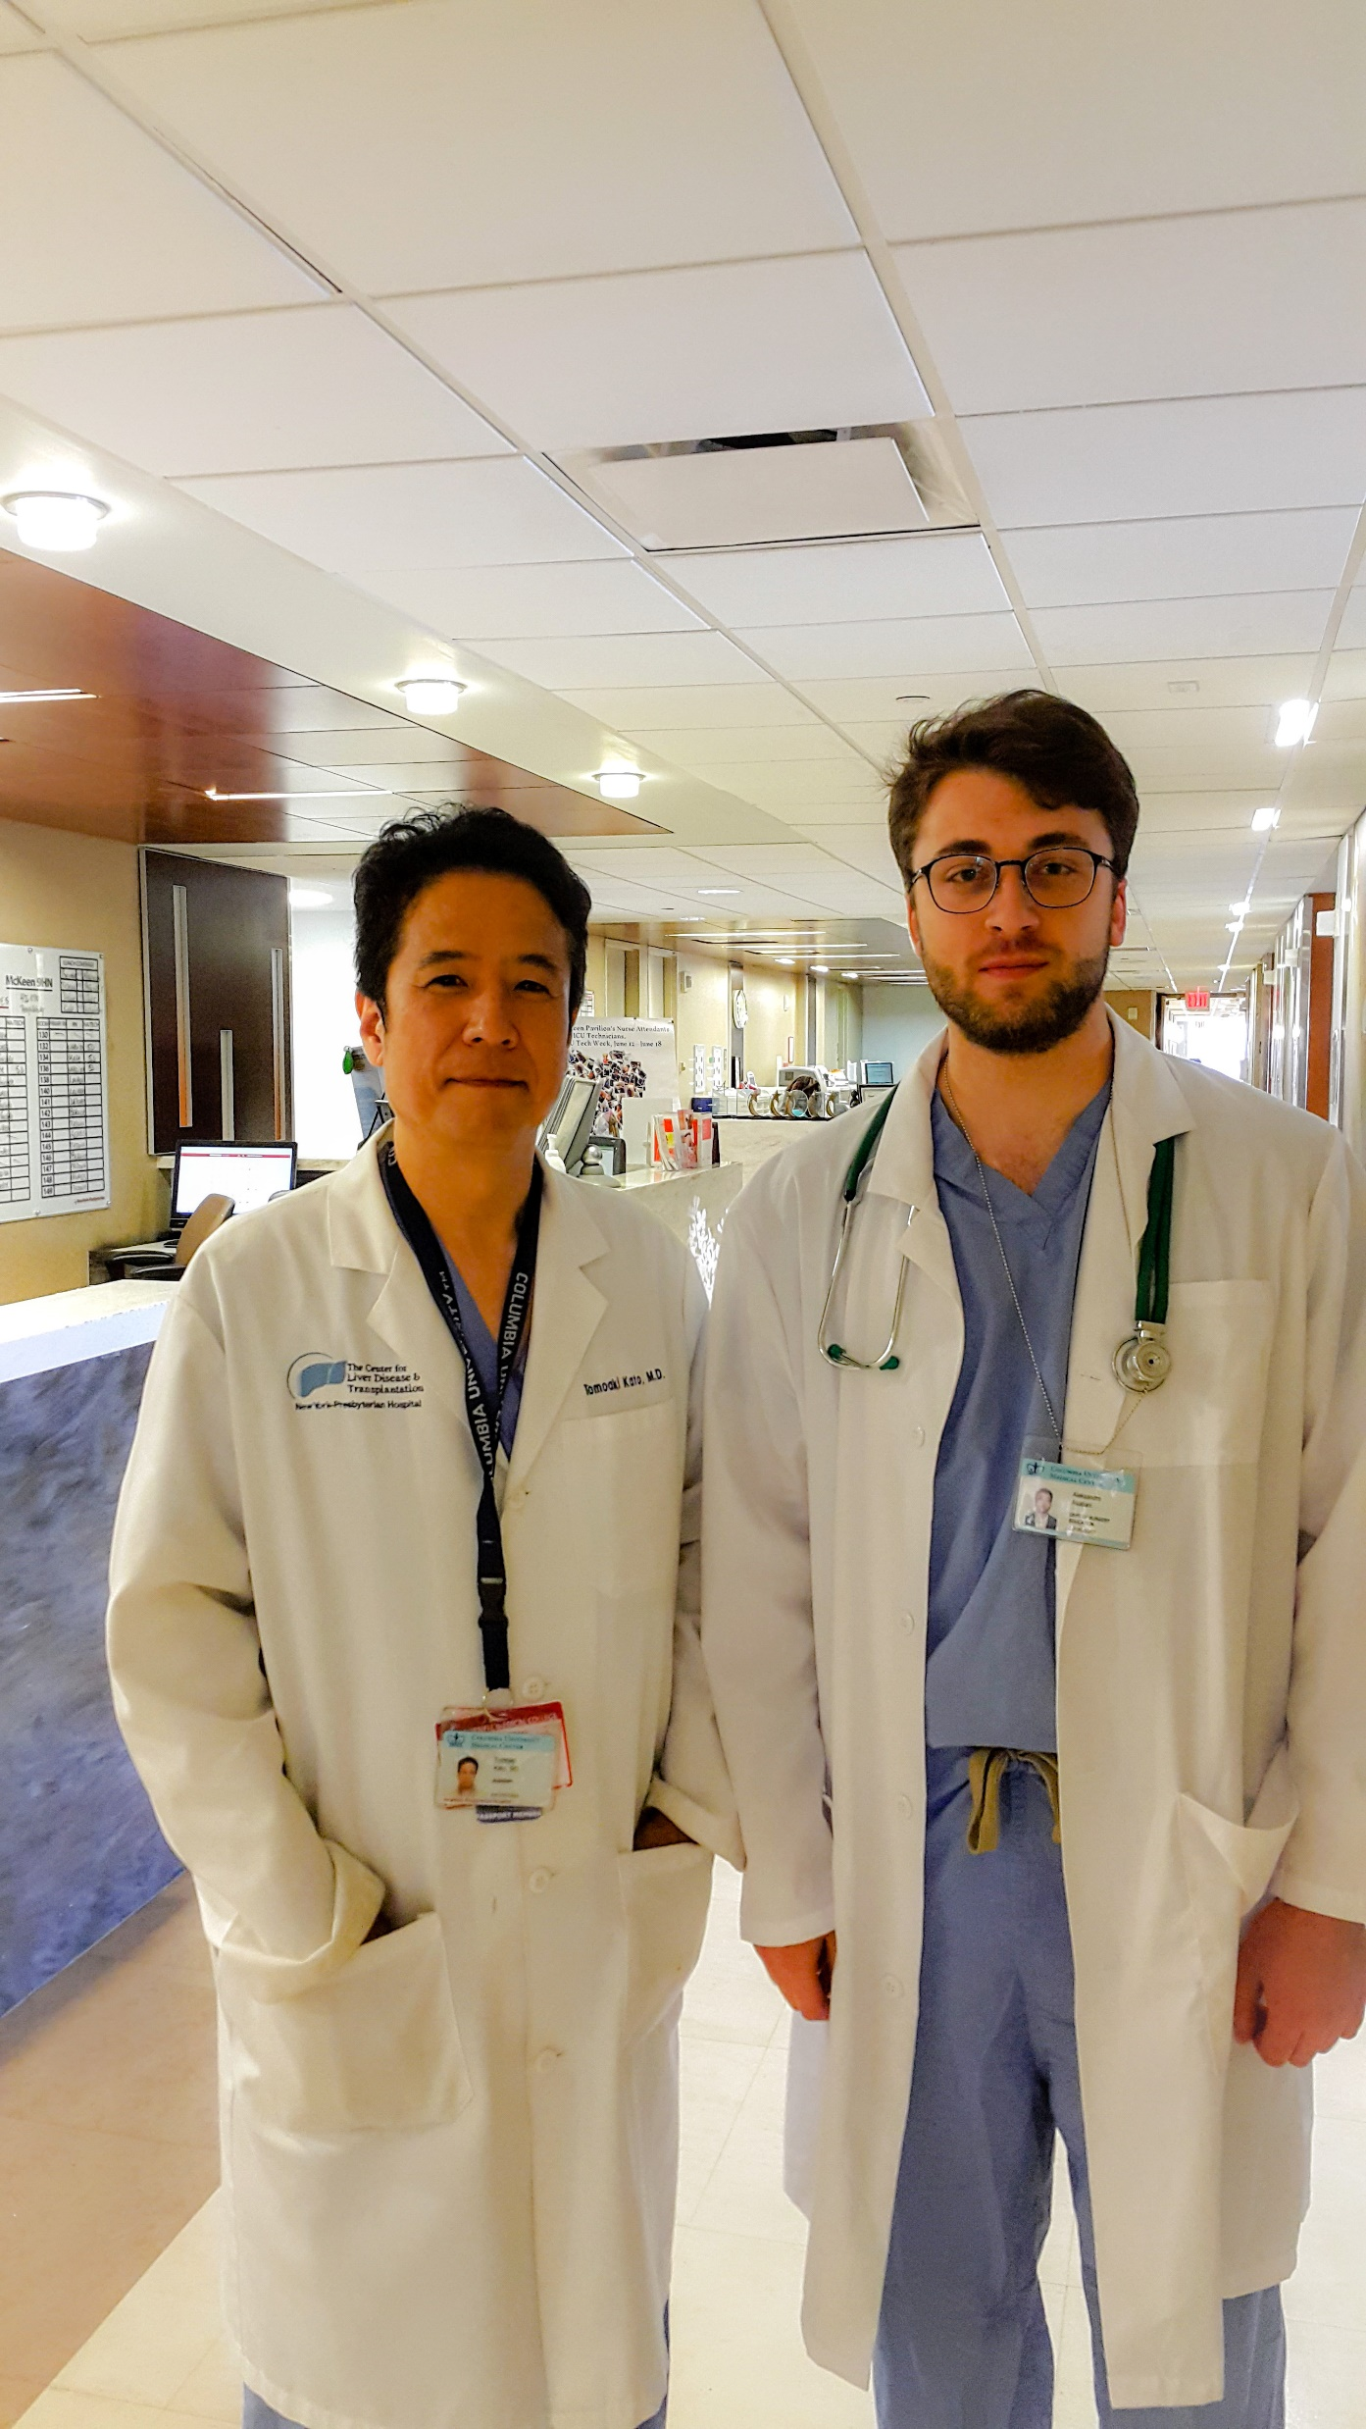
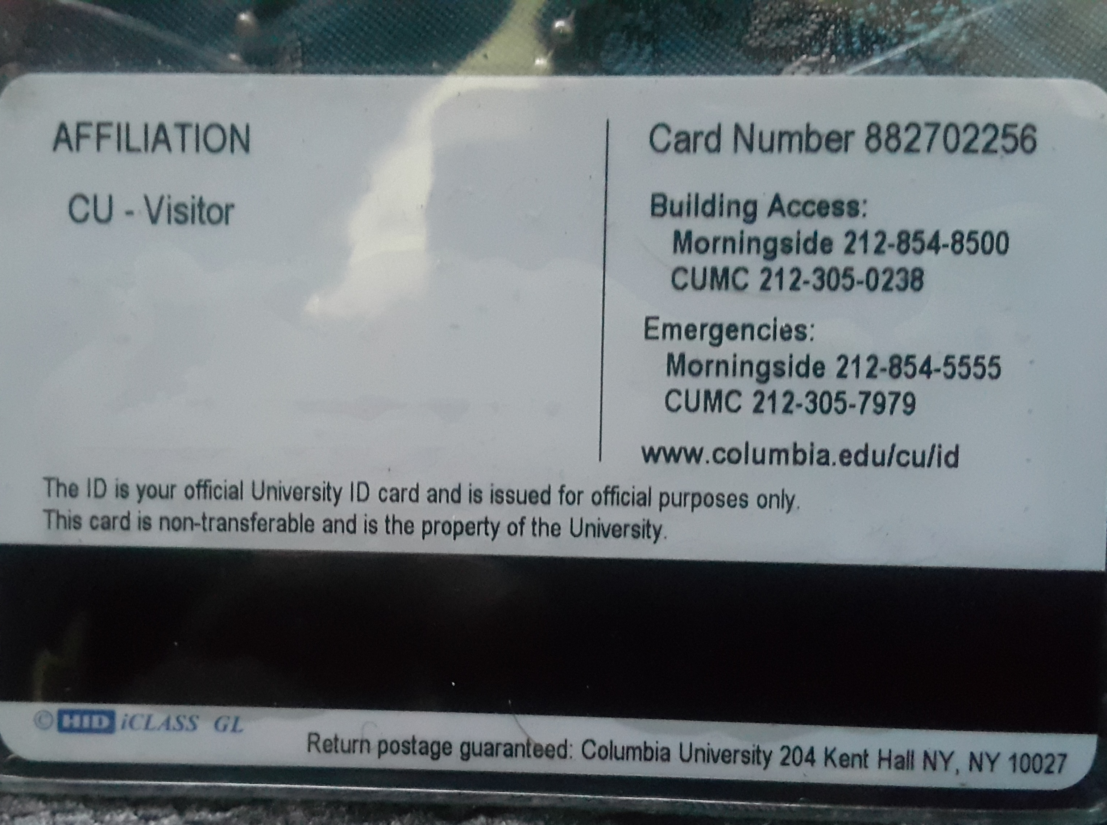
ID card
Scrub suit credit
White coat
Books
Door access codes
Codes
Schedule
Etc.

Slide 15
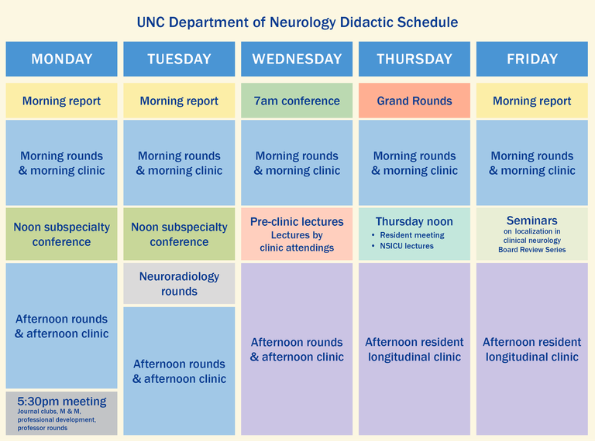
Basic hospital schedule

Slide 16
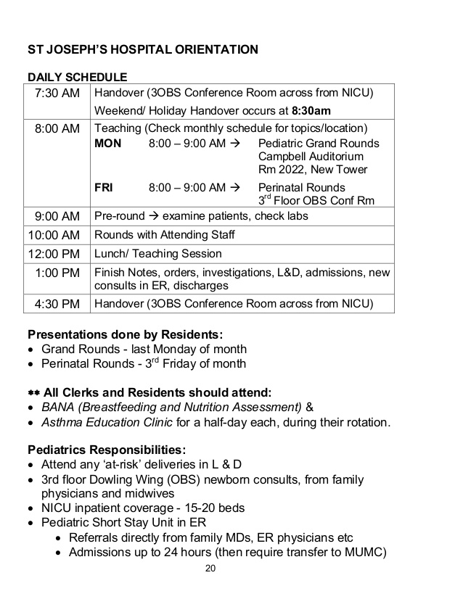
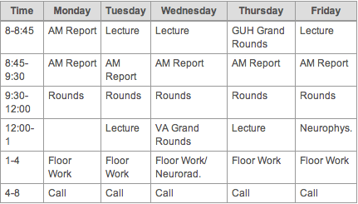

Slide 17
Step 3 - Get the ECFMG certification
Passing performance on USMLE Step 1, Step 2 Clinical Knowledge, and Step 2 Clinical Skills
Primary-source verification of your medical education credentials.
Step 1 – Pass the USMLE
Step 2 – Graduate from DTMU

Slide 18
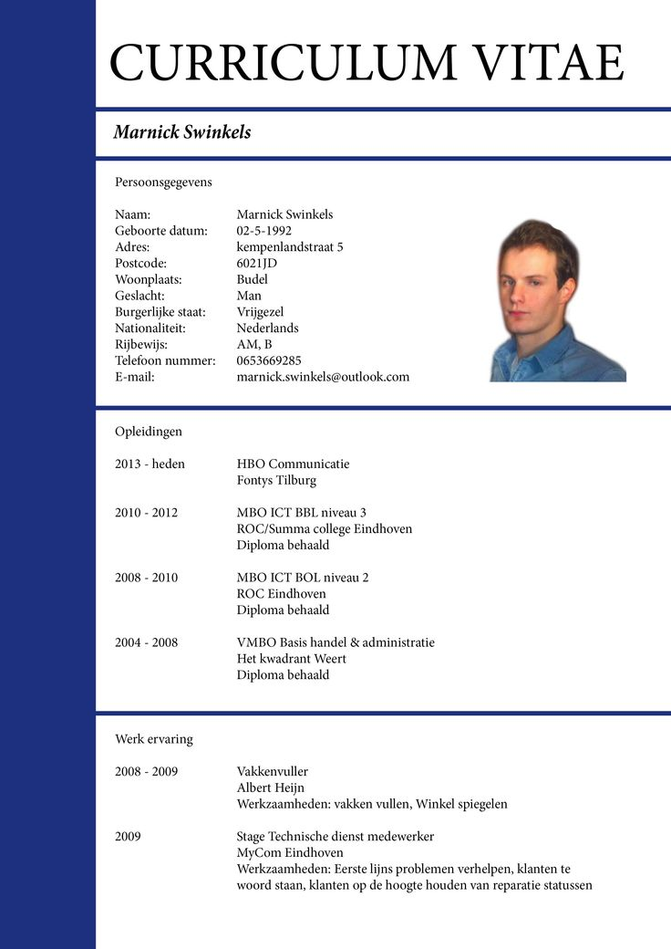
Step 4 - Apply for residency
ERAS application :
CV
Personal Statement
Letters of Recommendation
Medical Student Performance Evaluation (Dean’s letter)
USMLE Transcript

Slide 19
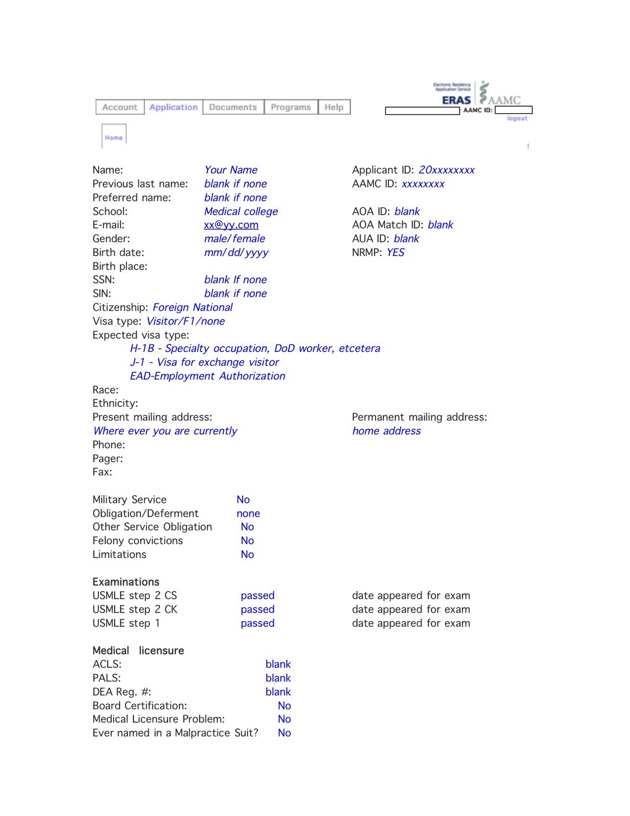
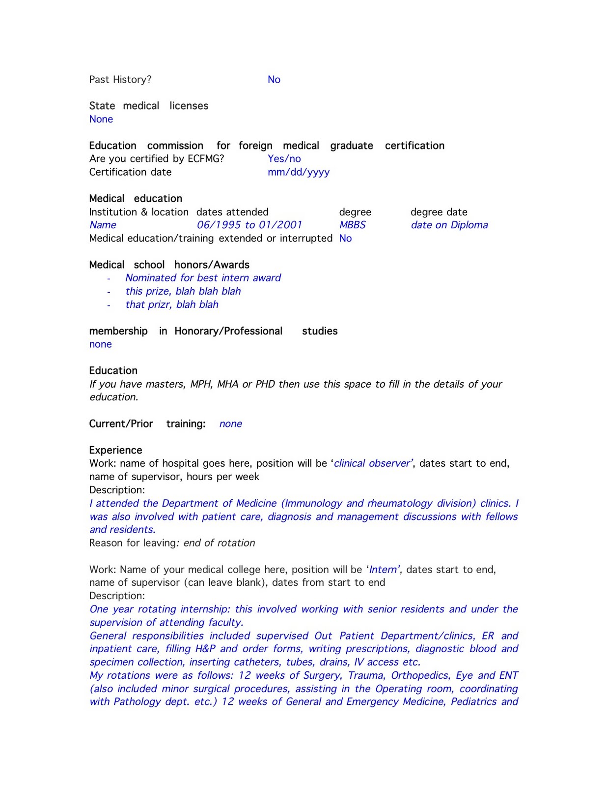
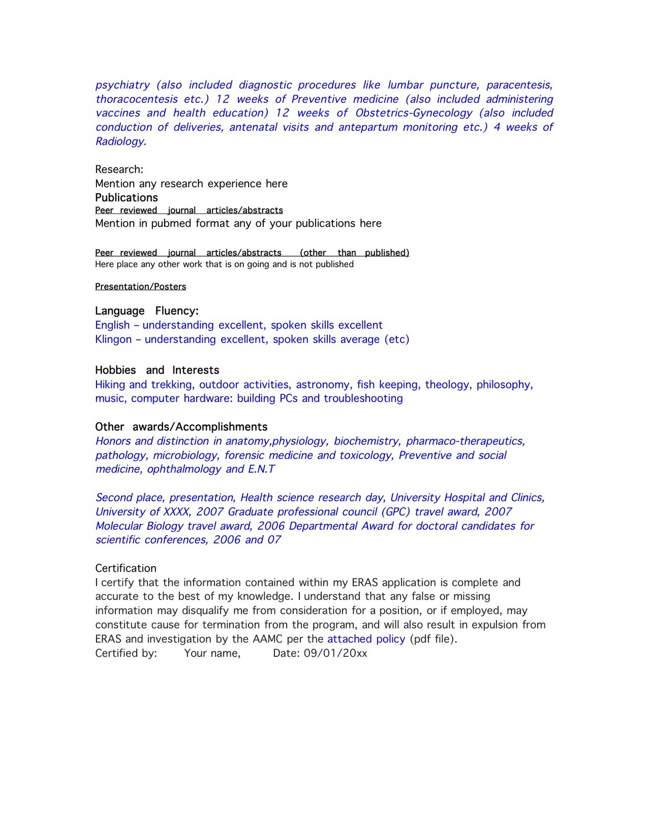

Slide 20
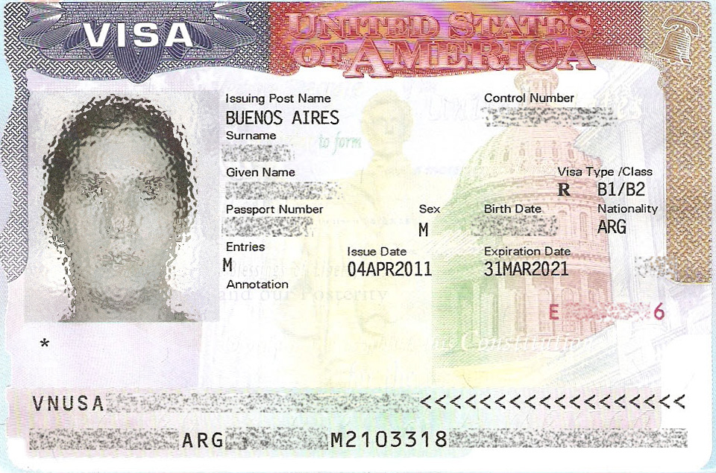
Step 5 - Get visa
B1 - Business visitors B2 - Tourism, vacation, pleasure visitors
B1/B2 – Combined visa J1 – Physicians/exchange programs
Letter of invitation/visa assistance

